Slide 1
Welcome!
HS Unwrapped
March 21st, 2021

Slide 2
Agenda
Welcome (Katie)
TRCS HS Overview (Dan)
College + Career Office (Ana)
Leadership Programming (Ana)
HS Experience Panel
(Katie, Pierre, & Students)
High School Selection Process (Raymond)
Questions + Concerns

Slide 3
“Renaissance is committed to graduating individuals who are competent, powerful thinkers, engaged citizens, and life-long learners who will create the renaissance of New York.”
This line from our mission statement sums up TRCS high school in a nutshell. We want our HS students to be leaders who challenge the status-quo, people who care about the world around them, and want to make their communities, both in and out of school, better places to live and learn.
We strive every day to teach students to be proficient writers, readers, artists, critical thinkers, geographically literate, imaginative problem solvers, scientific analysts, physically and emotionally healthy, and proponents of social justice. We care about your child’s character as much as their academic rank.

Slide 4
TRCS HS is small, about 220 students.
That’s just the way we like it. Why?
We know you – from teachers to office staff to school safety officers, we’re one community of learners!
Your teachers know YOU and YOUR STUDENT: strengths, area of need, personality.
We have the flexibility to add experiential learning whenever the opportunity arises--which means more artists and other experts in classes, more trips, more leadership opportunities and internships.
Students in small schools perform better academically, graduate at higher levels, are more likely to attend college, and earn higher salaries later on in life.*
*Source: Raywid,“Small Schools: A Reform That Works,”
Educational Leadership, 55(4), p.34-39

Slide 5
We can prove it, too.
For the last several years …
Regents exam data reflects TRCS curriculum rigor
Over 90% graduation rate; 97% college acceptance rate
97-100% college acceptance rate
We received an A for college & Career Readiness from the NYC Department of Education
We were the only charter school named as one of NYC’s top high schools by Daily News, AM NY and US News & World Report.

Slide 6
An Alumni Community of...
Artists + Creative Professionals
Cathy Messier (2007), graduate of Brandeis, playwright & actor
Lisette Lopez (2010), won prestigious internship with the art department of the Museum of Natural History
Daniel Sanchez (2006), NYC film industry professional as a production assistant, and writer/producer of documentaries.
Health Care Workers + Professionals
Samantha Aaron (2006), Posse Scholar - Vanderbilt U. Research scientist at the NYC Department of Mental Health
Law Professionals
Sam Gauthier (2008), J.D. awarded from CUNY Law. Posse Scholar, Trinity College, Hartford.

Slide 7
An Alumni Community of...
Entrepreneurs
Deep Patel (2005) owns a chain of convenience stores in upstate New York AND the fuel company that supplies his gas stations
Innovators
Luvana Chowdhury (2009), Fulbright Scholar finalist for developing a micro-chip to detect Dengue Fever
Tsechu Dolma (2010), received a Brower Youth Award in recognition of her efforts to create a model for sustainable food security in Nepal. Gates Millennium Scholarship recipient. Forbes 30 under 30 - Social Entrepreneur
Girelle Guzman (2002), Posse Scholar - Brandeis University developed our Leadership Program at Renaissance - currently Director of Membership and Operations - New Lab

Slide 8
An Alumni Community of...
Business Professionals
Brandee Williams (2005) Posse Scholar, Wheaton, MA. Public relations professional
Conor McCoy (2004) Posse Scholar, Depaw U. Investment broker, member of Board of Trustees of TRCS, President of the Friends of Renaissance Board.
Karen Campos (2010) Senior Product Manager FCB Health
Organizers, Social Entrepreneurs
Leanne Sajor (2011) Program Coordinator for Economic Policy and Human Rights, International Network for Economic, Social & Cultural Rights. Co-Founder Renaissance Charter HS for Innovation. London School of Economics graduate.
Alejandra Ruiz (2004) Executive Director, Youth Engagement Fund. Cornell University.

Slide 9
An Alumni Community of...
Engineering Professionals
Jonathan Rivas (2008), Engineer’s Assistant at Hazen & Sawyer Environmental Engineers
Julian Laverde (2004) - Design Engineering, Exelon Corporation
Education Professionals
Claudia Martinez (2006), received her M.Ed from Harvard
Jose Mane (1999) completed graduate work at Columbia, teaches Global Humanities at TRCS.
Pierre Dizon (2005), Posse Scholar, Wheaton, MA. TRCS MS Social Studies teacher, received degree in special education
Alex Smith (2000), Sports Coordinator and integral staff member at TRCS.

Slide 10
Highlights of the TRCS HS Program
*More information for these can be found on the TRCS website*
Advisories
AP Courses
Staff and Curriculum
College + Career Office
Leadership Program
Extracurricular Activities
Student Government, National Honor Society, Spanish Honor Society
Individual Attention
Your Student Has a Voice!

Slide 11
College + Career Office
Ana Falla-Riff
College Adviser, Coordinator for College Bound

Slide 12
College and Career Office
College/Career Counseling/CB Coordinator
Literacy/Math Skills
Senior Seminar
Leadership Program
Ana Falla Riff
Maura Malarcher
Inti Ossio

Slide 13
College and Career Office &
Leadership Programming
Who: Ana, Maura & Inti
What:
Become acquainted with high school graduation requirements
Explore their interests and careers through academic and leadership programs
CUNY - College Now, research and apply to colleges
Social Justice Day and Career Day
Scholarships - Posse, Questbridge
College Fairs/College Representatives

Slide 14
College and Career Office
College/Career Counselor/HS Coordinator
Literacy Skills/
Senior Seminar Teacher
Leadership Program Coordinator
Ana Falla Riff
Maura Malarcher
Inti Ossio

Slide 15
Leadership
Opportunity Examples
WHAT IS LEADERSHIP?
Participation motivates students to answer two essential questions directly related to TRCS’s mission:
How can I make the world a better place?
How do I want to contribute to the world when I am older?
Sadie Nash Leadership Project
Elite Web Design
Urban Word
The Opportunity Network
Sponsors for Educational Opportunity
The Possibility Project
Weill Cornell Professionals Recruitment and Exposure
High School Law Institute Columbia U.
NYCLU - Teen Activist Project

Slide 16
College and Career Office
We strive to help students create an academic and career portfolio that reflects her/his aspirations, goals, dreams, and skills.
Create curricula that reflects our students’ needs.
Engage parents as partners in their children’s education.
Grade meetings
Financial Aid Workshops
Individual meetings with parents/guardians
Work with faculty and staff to create individualized student plans.
College and Career Office: http://trcscollegeoffice.blogspot.com/

Slide 17
College and Career Office
Exposes students to academic and extracurricular leadership opportunities:
City University of New York (CUNY) College Now Program
Queens College
Bronx Community College
School of Professional Studies
John Jay School of Criminal Justice
The Opportunity Network
OppNet Prep
OppNet Fellows
The Posse Foundation
Lafayette
Trinity (CT)
Brandeis
Sadie Nash Leadership Project
Saturation Model
Role Models Mentoring Program
Summer Leadership Institute
Social Justice Day
Career Day

Slide 18
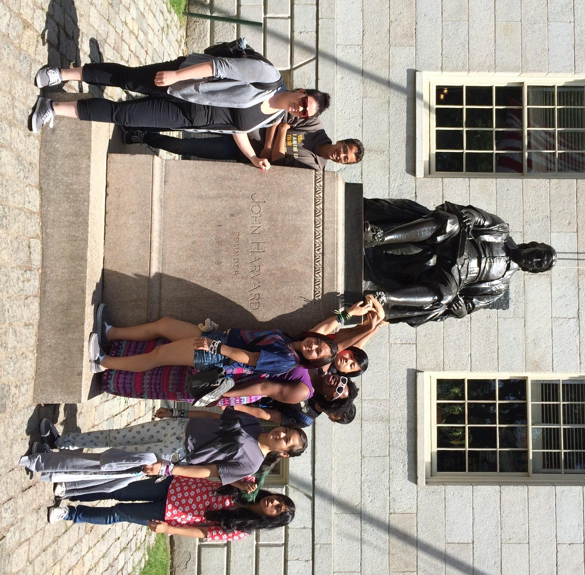
College Acceptance
City University of New York (CUNY)
Macaulay Honors at Hunter College
Baruch College Honors
Brooklyn, Queens, Hunter, City, BMCC, LaGuardia
State University of New York (SUNY)
Binghamton, Stony Brook, Albany, Buffalo, Fashion Institute of Technology, Cobleskill
Private
Barnard
College of St. Rose
Cornell
Hofstra
Juniata
Wellesley
New York University
Swarthmore
Union
Syracuse

Slide 19
Highlights of the TRCS HS Program
Advisories
AP Courses
Staff and Curriculum
College and Career Office, Leadership Program
Extracurricular Activities
Student Government
Individual Attention
Your Student Has a Voice!

Slide 20
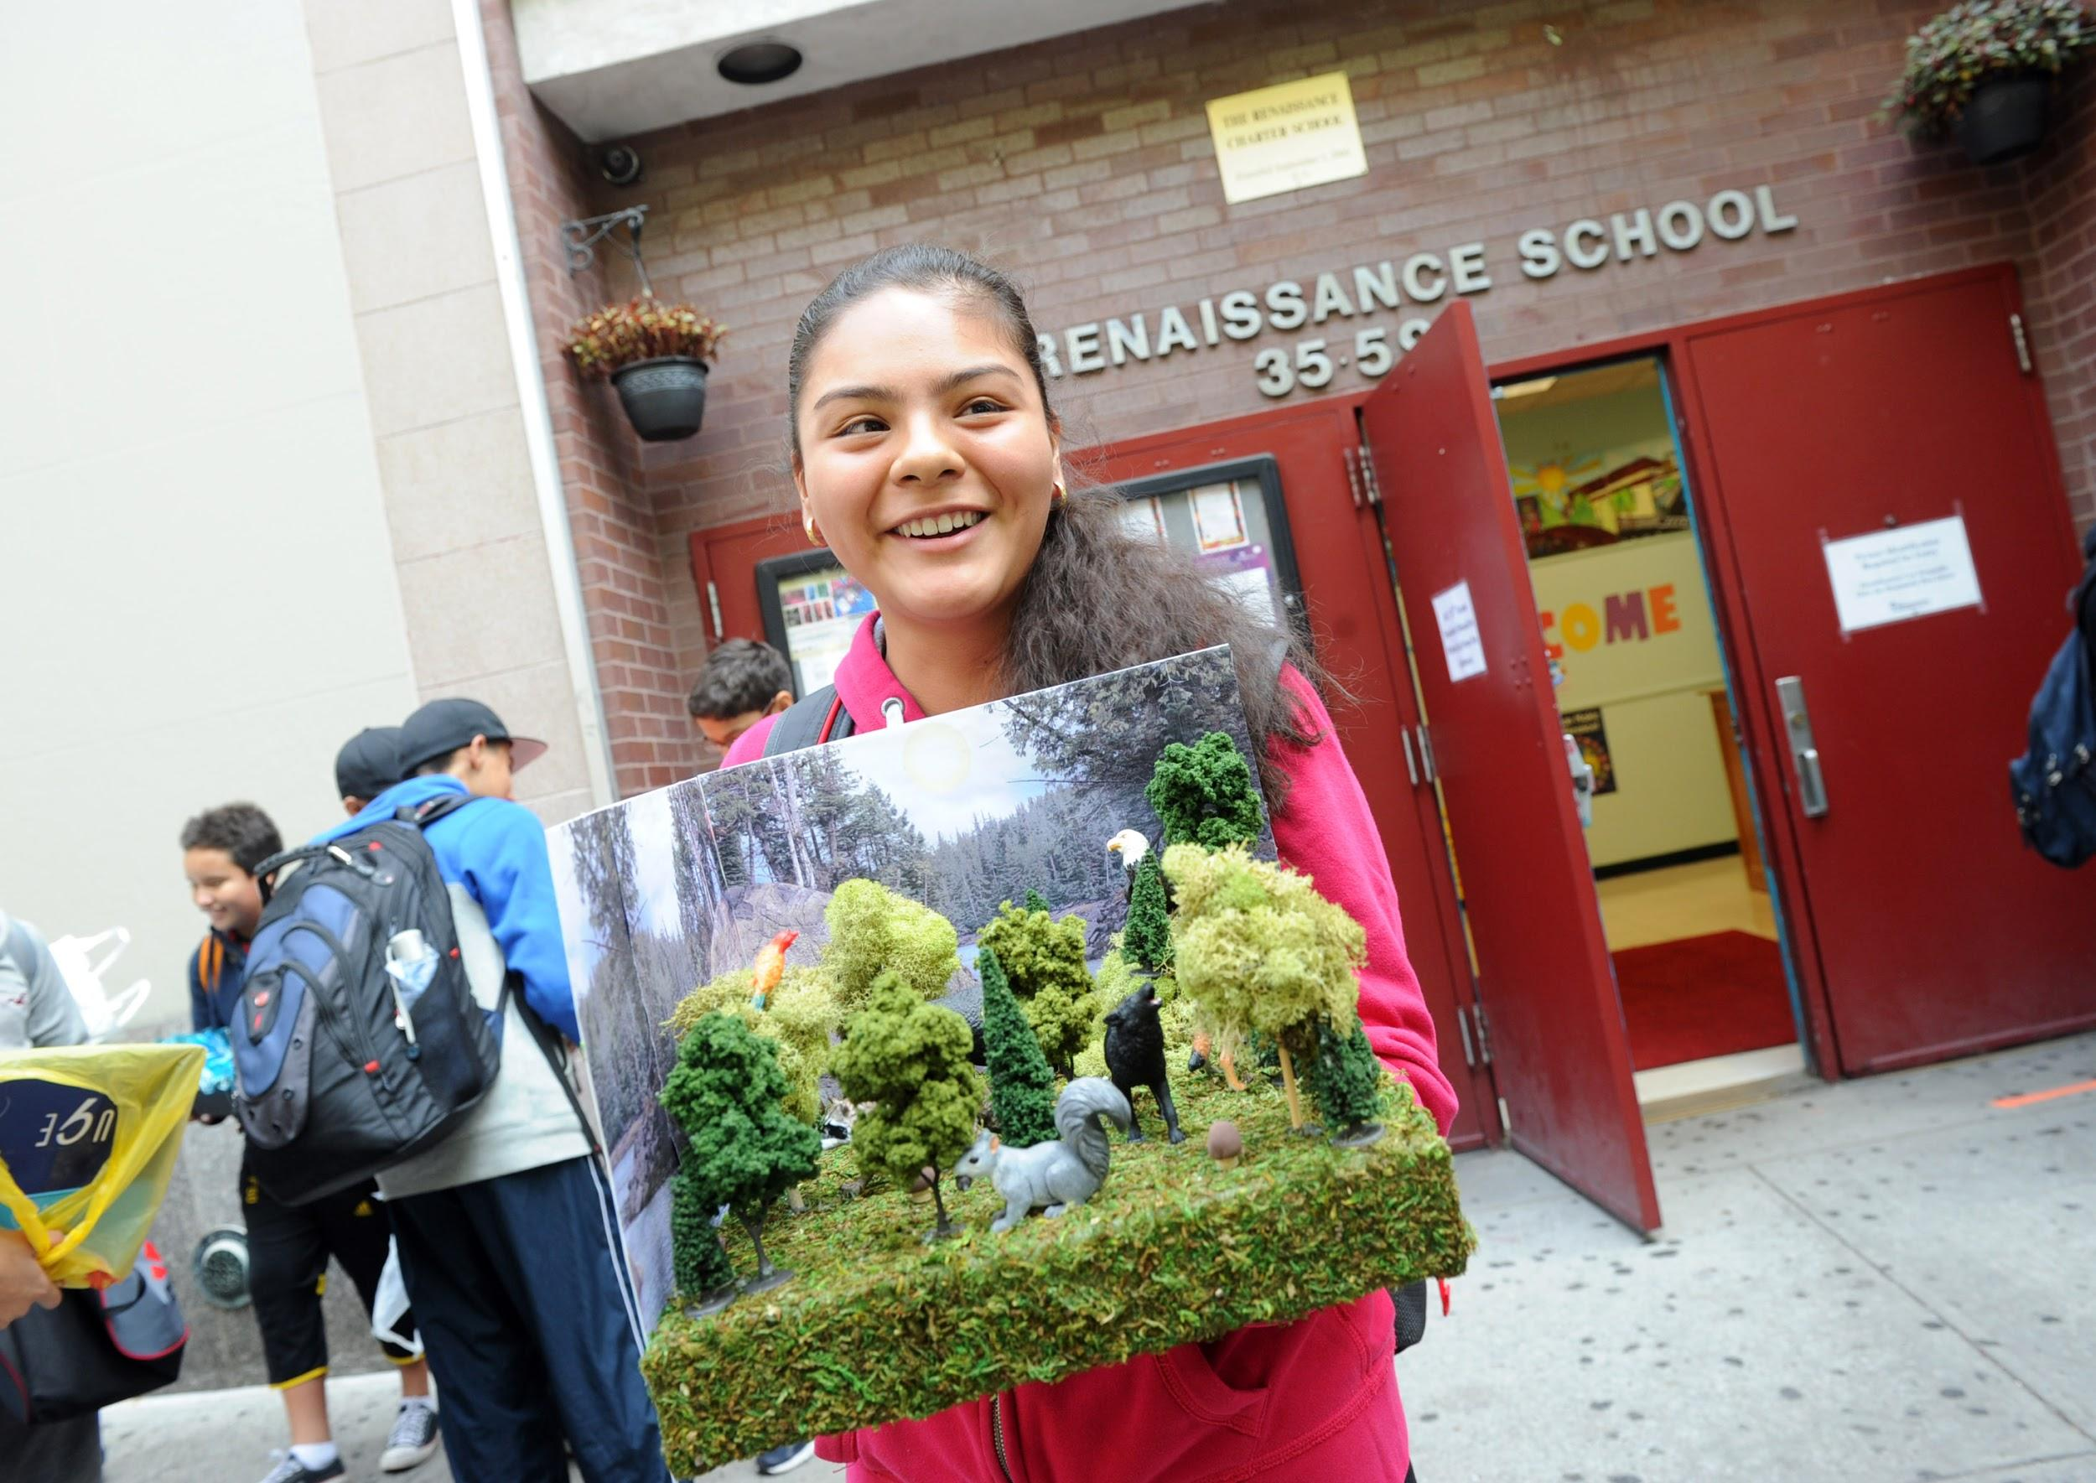
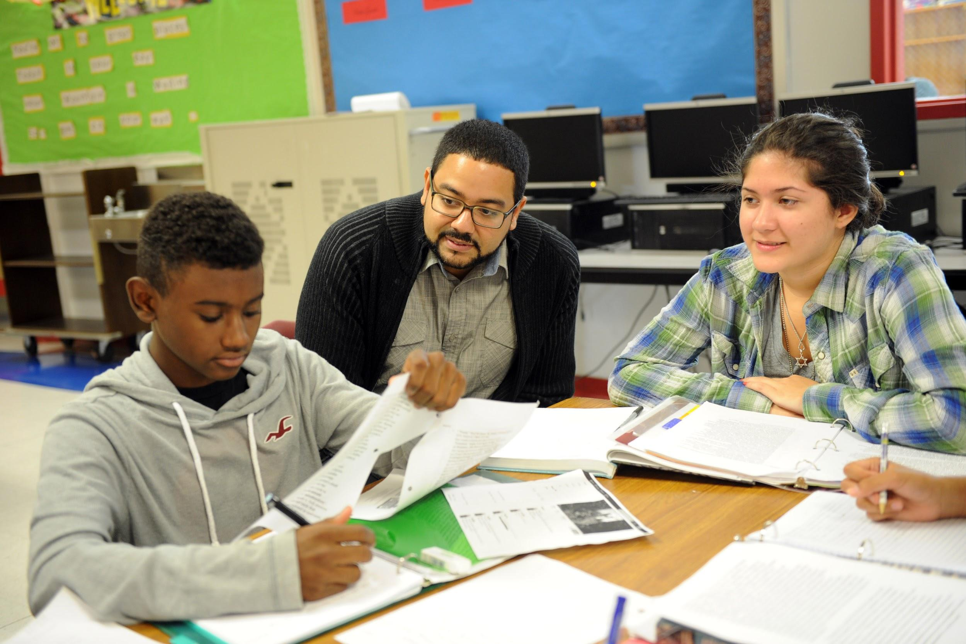
Curriculum
9th Grade:
Algebra /Geometry
Global Studies/Humanities
Living Environment
ELA
Spanish
Health + P.E.
College Bound
Arts
Advisory
Physical Education
10th Grade:
Geometry
Global Studies
Global Lab
ELA
Chemistry
College Bound
Spanish
Arts & P.E.
Advisory
AP Class Options

Slide 21
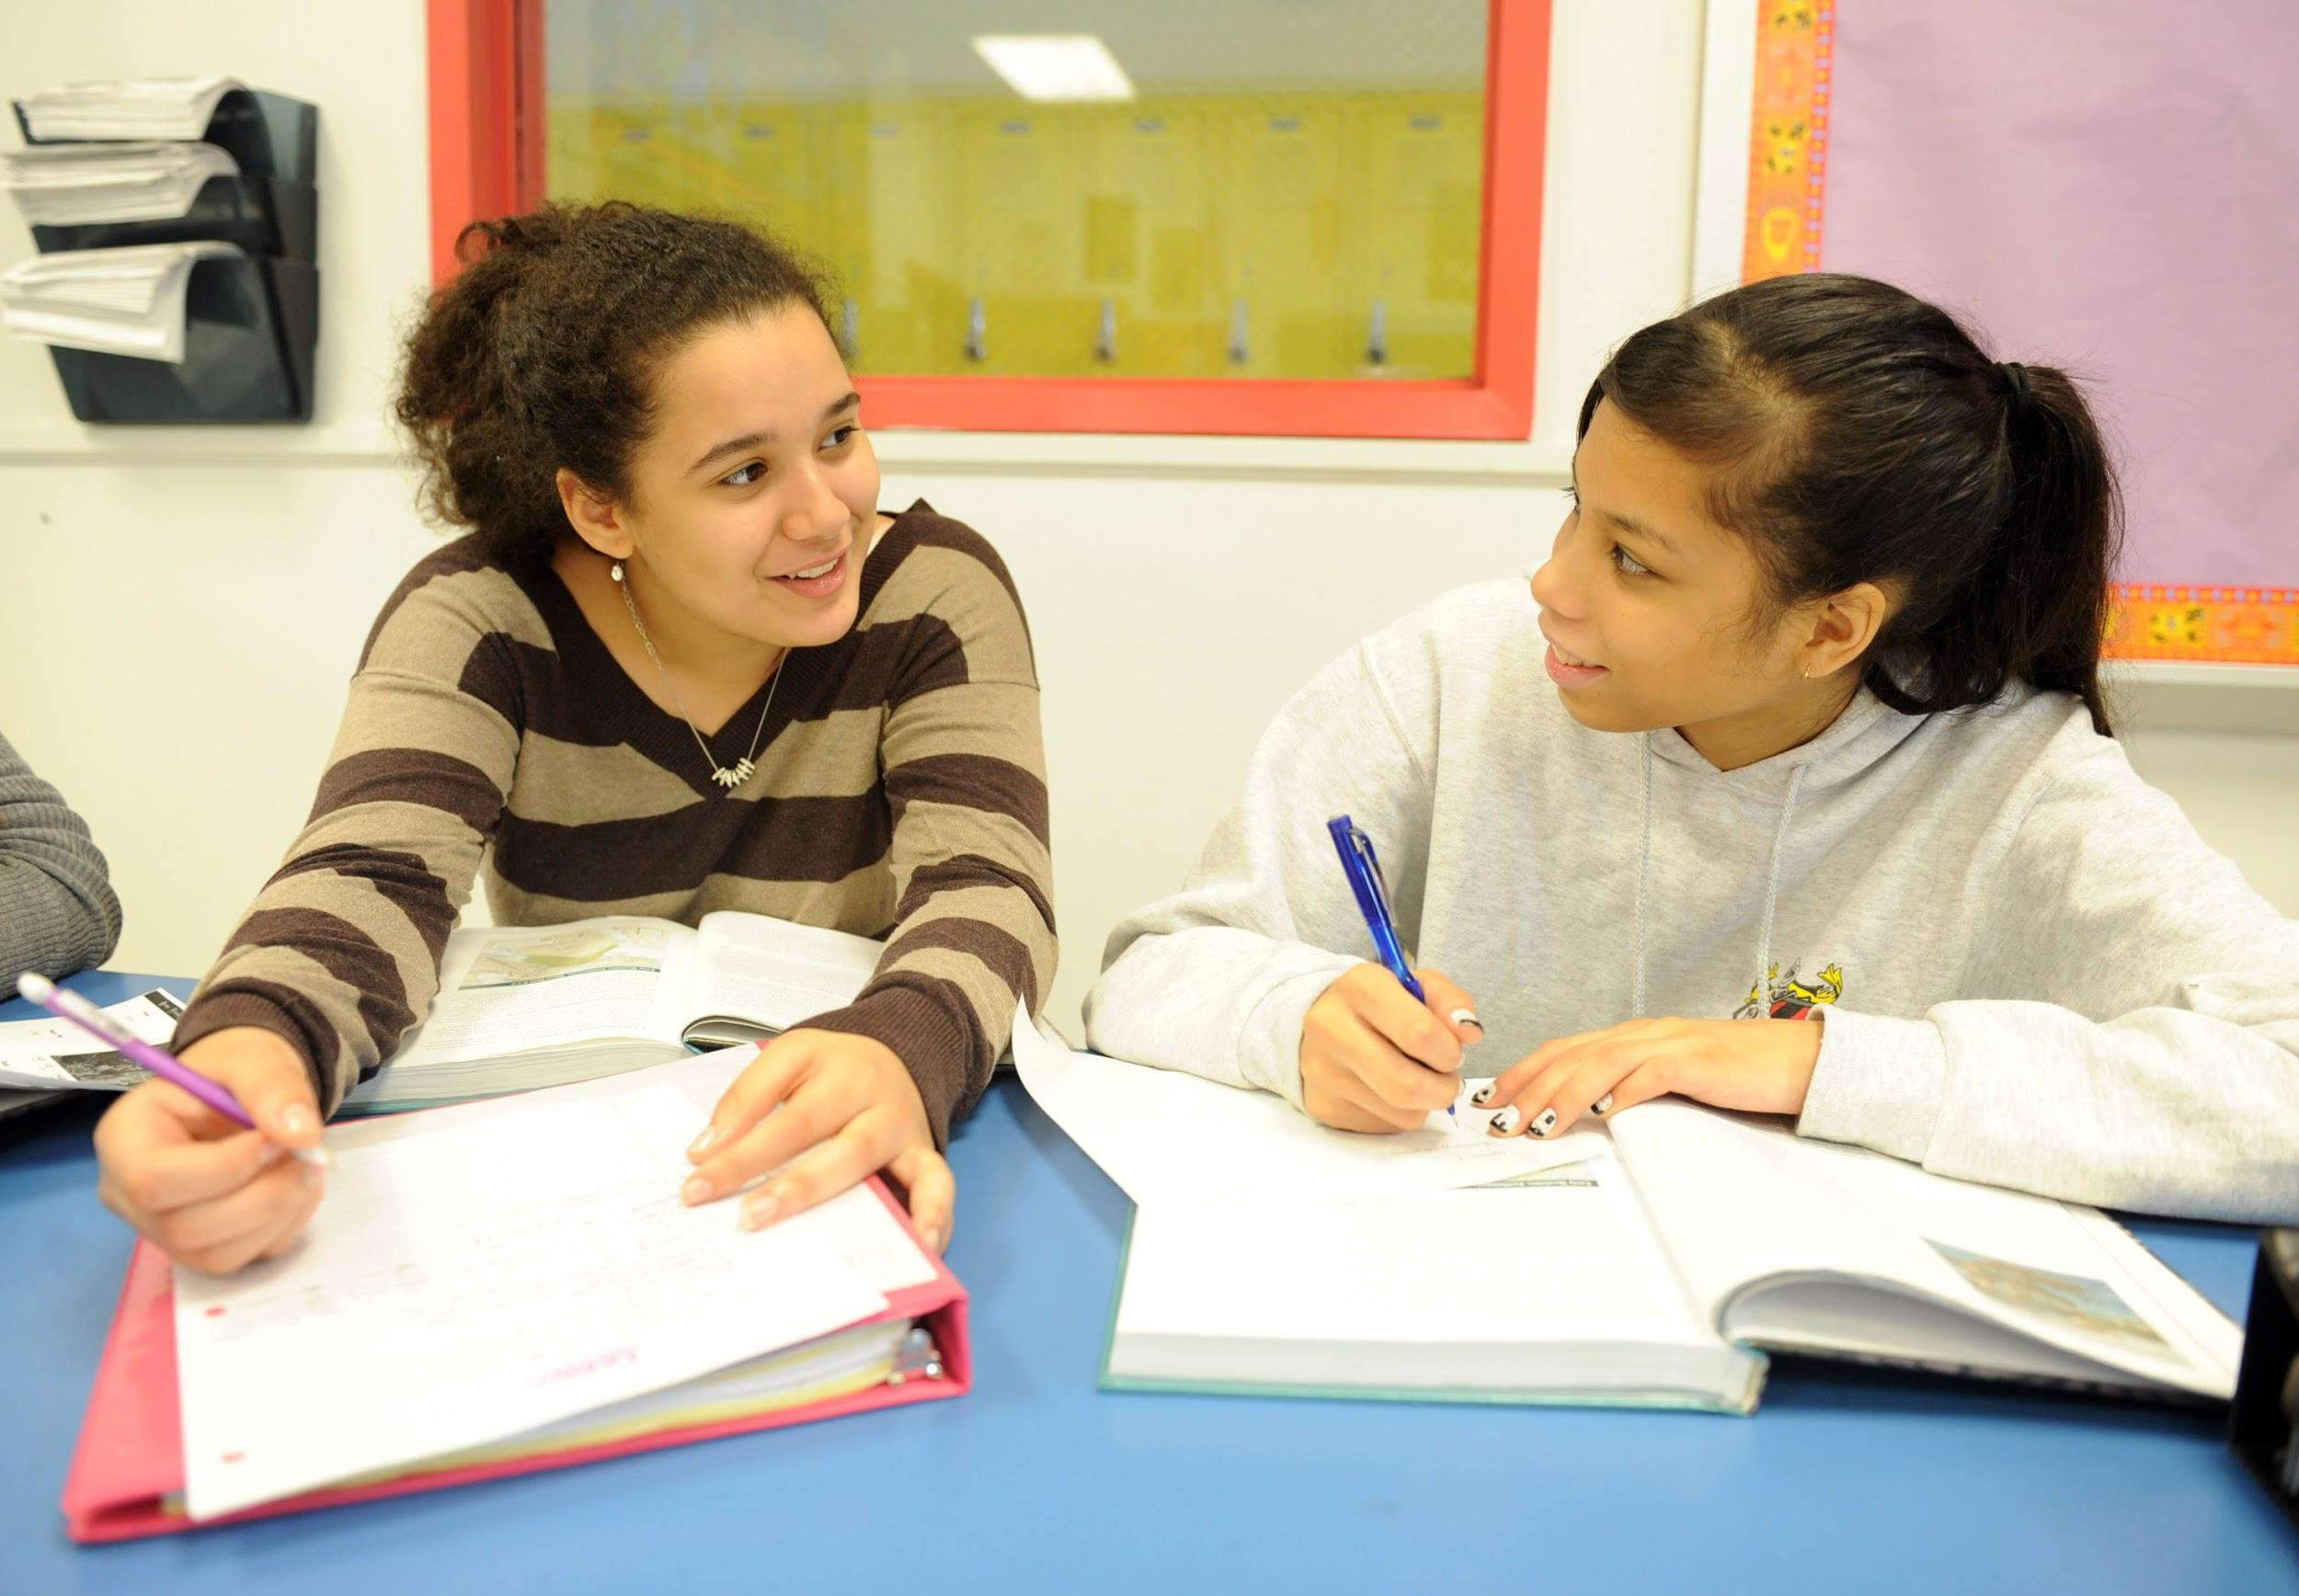
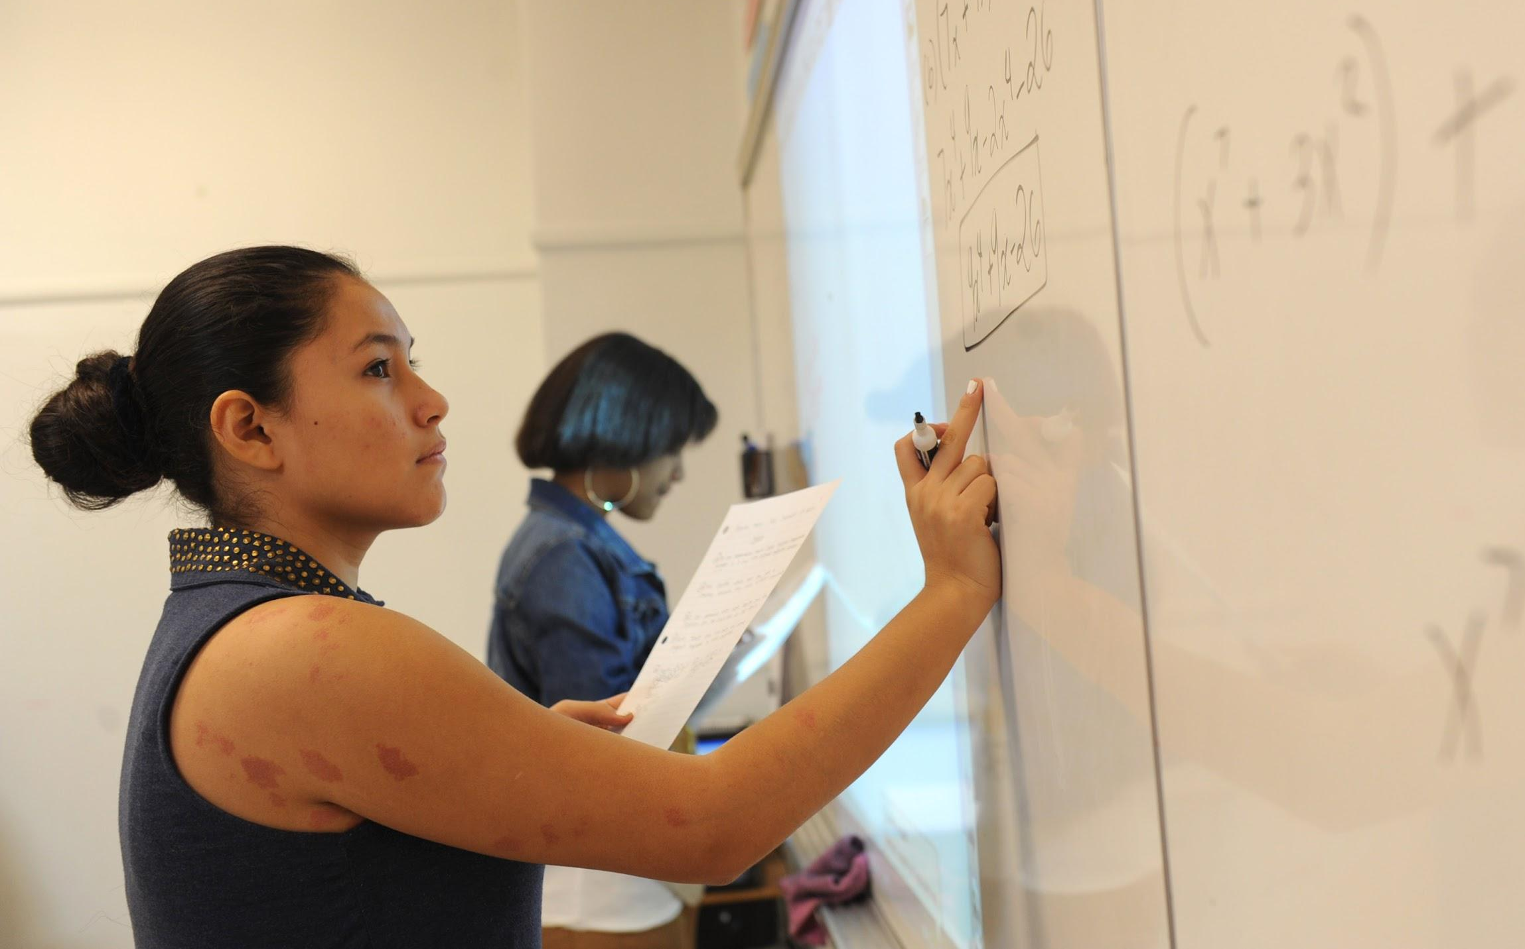
Curriculum
11th Grade:
Algebra 2/Trig
US History
ELA (Honors Option)
Spanish
Physics,Computer Science or Agriculture
College Bound
Arts & P.E.
Advisory
AP Class Options
12th Grade:
Senior Seminar
Pre-Calculus or Calculus
ELA
Government/Economics
College Bound
Agriculture, Physics, AP Bio, or AP Environmental
AP Spanish
P.E.

Slide 22
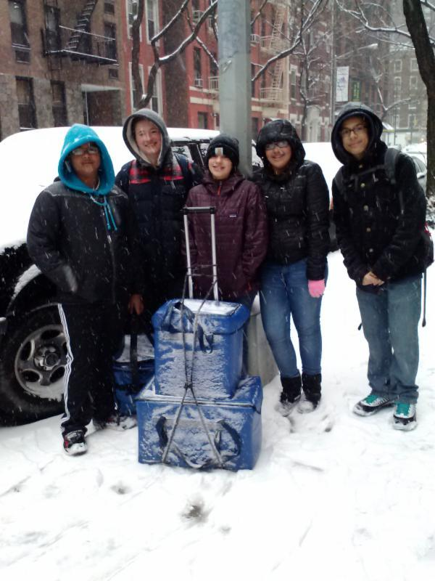
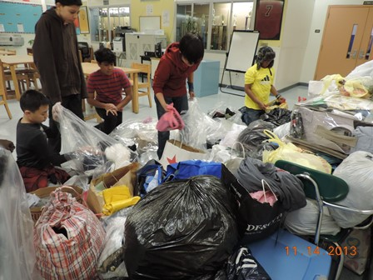
Advisories
The advisory program focuses on creating a safe space where advisors can enhance students’ social-emotional development and work on team -building. Three major goals guide the work of Advisory:
Support Students In Monitoring Academic Goals
Support Students’ Social-Emotional Development
Promote Community Service from Student Initiatives
HS Advisors are drawn from the middle and high school staff, in order to keep the size of the groups small. Students in 9th and 10th grades start every day with advisory, and 11th grade with homeroom. 12th graders have Senior Seminar to address senior-specific issues, plans, college applications and scholarship essays, among other things.

Slide 23
AP Courses
Advanced Placement Courses:
Students are encouraged to take AP classes, to challenge themselves and develop a competitive transcript that will attract the college of their choice.
Advisors will inform students when there is an option to do higher level work in a particular class. Because classes are weighted, a student’s rank in the graduating class will reflect the level of difficulty of his or her coursework.
Biology
World History
Spanish Language
U.S. History
English Literature
Computer Science
Environmental Science

Slide 24
Extracurricular Activities
Robotics Club
Tech Crew
Rensizzle
Sports Teams
Sewing Club
Student Government
Peer Mediation
Yearbook Committee
Future Farmers of America
National Honor Society
Sociedad Honoraria Hispánica
Curtain Up! Drama Club
Jazz Band
Photography, Graphic Novel, Computer Animation…
Have another idea? Let us know!

Slide 25
TRCS
High School UnWrapped 2021
Presented by members of the High School Student Government, National Honors Society, Spanish Honors Society and other High School Leaders.
Notes:
NOTE: SLIDES 1-19 WILL SCROLL, 6PM PRESENTATION STARTS ON SLIDE 20!

Slide 26
Why should you attend
The Renaissance Charter High school?
Notes:
NOTE: SLIDES 1-19 WILL SCROLL, 6PM PRESENTATION STARTS ON SLIDE 20!

Slide 27
College and Career Office
College/Career Counseling/CB Coordinator
Literacy/Math Skills
Senior Seminar
Leadership Program
Ana Falla Riff
Maura Malarcher
Inti Ossio

Slide 28
About: College and Career Office
Who: Ana, Maura & Inti
What:
-Become acquainted with high school graduation requirements
-Explore their interests and careers through academic and leadership programs
-CUNY - College Now
-Research and apply to colleges
-Social Justice Day and Career Day
-Scholarships - Posse, Questbridge
-College Fairs/College Representatives
Notes:
NOTE: SLIDES 1-19 WILL SCROLL, 6PM PRESENTATION STARTS ON SLIDE 20!

Slide 29
Extracurriculars (Leadership)
WHAT IS LEADERSHIP?
Participation motivates students to answer two essential questions directly related to TRCS’s mission:
How can I make the world a better place?
How do I want to contribute to the world when I am older?
- Sadie Nash Leadership Program
- Elite Web Design
- Urban Word
- The Opportunity Network
- Sponsors for Educational Opportunity
- The Possibility Project-
- Weill Cornell Professionals Recruitment and Exposure
- MedDocs - Icahn School of Medicine, Mt. Sinai
- High School Law Institute at Columbia University
NYCLU - Teen Activist Project
Notes:
NOTE: SLIDES 1-19 WILL SCROLL, 6PM PRESENTATION STARTS ON SLIDE 20!

Slide 30
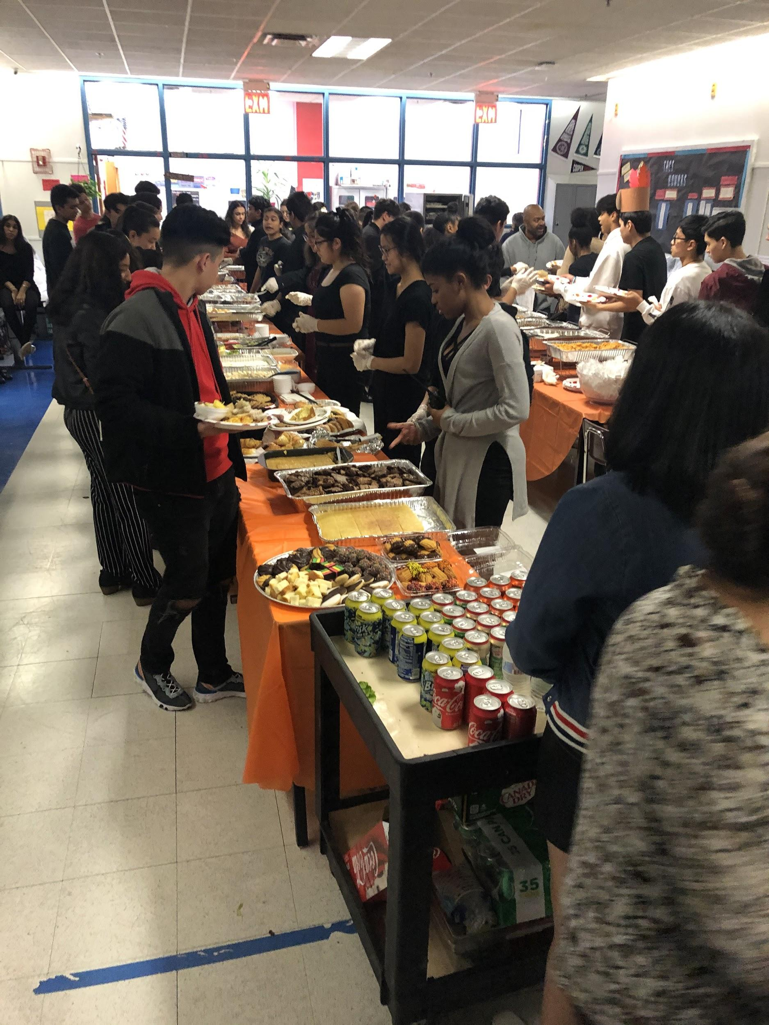
Thanksgiving
Feast and Social Justice Day, Hosted by Juniors
Holiday Feast Hosted by Seniors
*You are given creative abilities..
-Decorating (theme)/ food
-You get to share your favorite meal from home with the rest of the high school
-One last big memory with your classmates!
*You are given creative abilities..
-Decorating (theme)/ food
-You get to share your favorite meal from home with the rest of the high school
-One last big memory with your classmates!
(This year the pandemic prevented this.. But it is a tradition that will return!)
Notes:
NOTE: SLIDES 1-19 WILL SCROLL, 6PM PRESENTATION STARTS ON SLIDE 20!

Slide 31
Advanced placement opportunities
Social Studies:
AP World History
AP US History
Honors Economics
Honors Government
AP European History
Science:
AP Biology
AP Environmental Science
AP Computer Science
Language:
Honors English
AP English Literature
AP Spanish Language
AP Spanish Literature and Culture
Notes:
NOTE: SLIDES 1-19 WILL SCROLL, 6PM PRESENTATION STARTS ON SLIDE 20!

Slide 32
Relationships with our teachers
The relationship between the students and teachers are very important. In the high school, our teachers are very open and honest with us. They are extremely understanding, supportive and caring. They make us feel comfortable.
Our teachers always make sure that our voices are heard!
Notes:
NOTE: SLIDES 1-19 WILL SCROLL, 6PM PRESENTATION STARTS ON SLIDE 20!

Slide 33
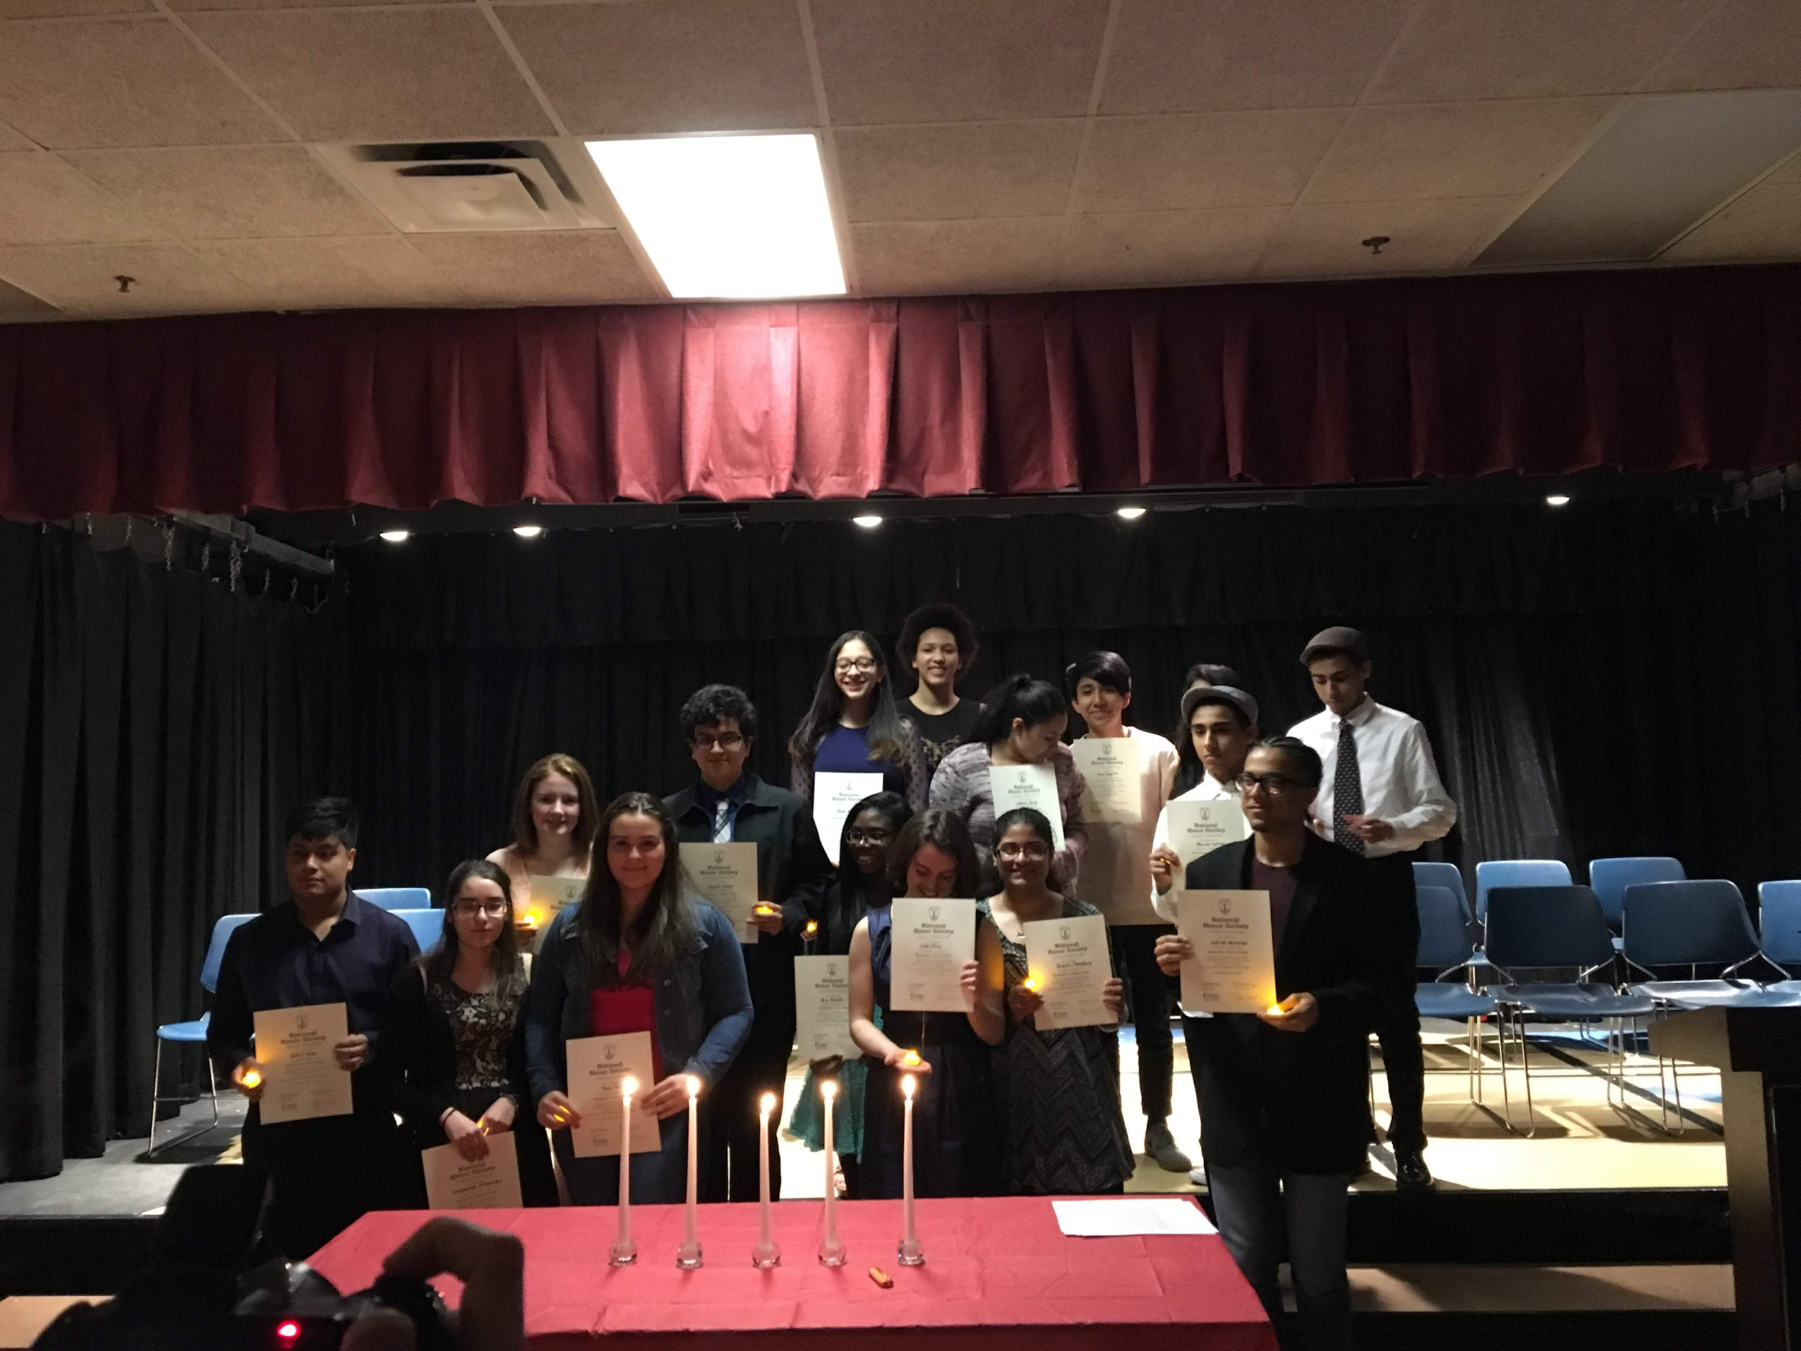
Student Academic Honors Organizations
*Spanish Honors Society:
Lisjane, 11th/12th grade
*National Honors Society:
Erin, 11th/12th grade
*Applications are sent out to 10th Grade Students to encourage them to apply
Notes:
NOTE: SLIDES 1-19 WILL SCROLL, 6PM PRESENTATION STARTS ON SLIDE 20!

Slide 34
High School Student Government
*Facilitated by Nicole Jollon: English Teacher
This leadership group in the High School is the voice of the students. We work on policies that impact students, student events, activities and fundraisers.
In order to be a part of this organization:
-You can be elected starting from 9th grade all the way up to 12th grade
-You can even be re-elected
-There are 3 positions for each grade (Fundraising Committee, Community Awareness and an Alternate)
Notes:
NOTE: SLIDES 1-19 WILL SCROLL, 6PM PRESENTATION STARTS ON SLIDE 20!

Slide 35
Clubs!
*GSA Club: With Lisa
*Theater Productions: With Rebecca S. & Curtis
*Run Club: With Martin
*Peer Mediation
*Himalayan Club
*Asian Pacific Islander Student Association: With Pierre
*Student Government!: With Nicole
*Feel free to create your own clubs!
Notes:
NOTE: SLIDES 1-19 WILL SCROLL, 6PM PRESENTATION STARTS ON SLIDE 20!

Slide 36
Sports:
Girls Varsity Volleyball: Dhariana
Soccer: Vinny
Boys & Girls Varsity Basketball: Vinny and Alex
**You might even be able to get other teams with enough people interested**
Notes:
NOTE: SLIDES 1-19 WILL SCROLL, 6PM PRESENTATION STARTS ON SLIDE 20!

Slide 37
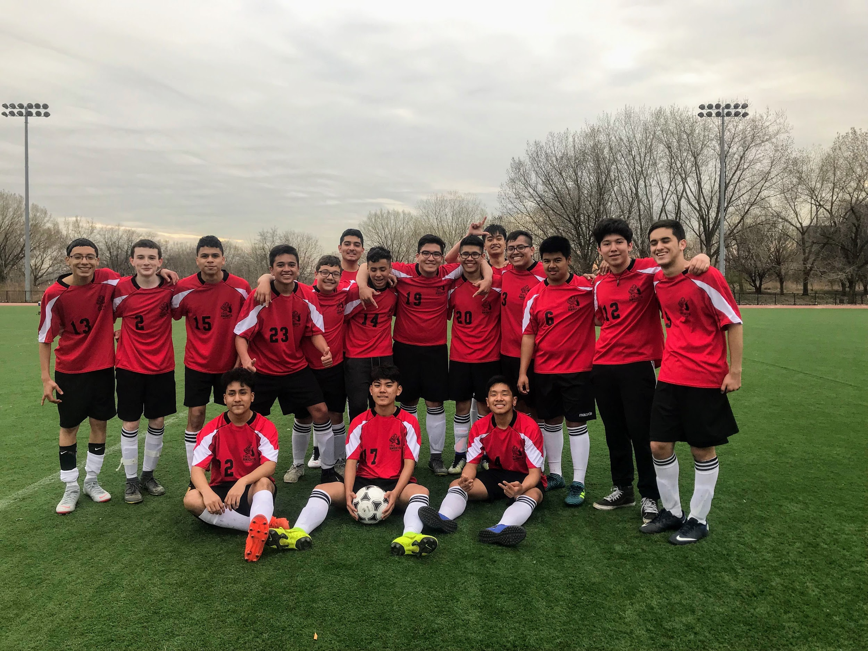
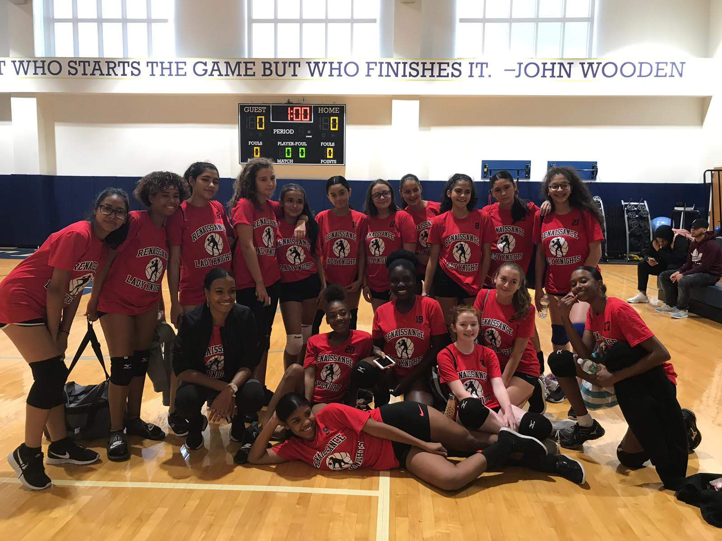
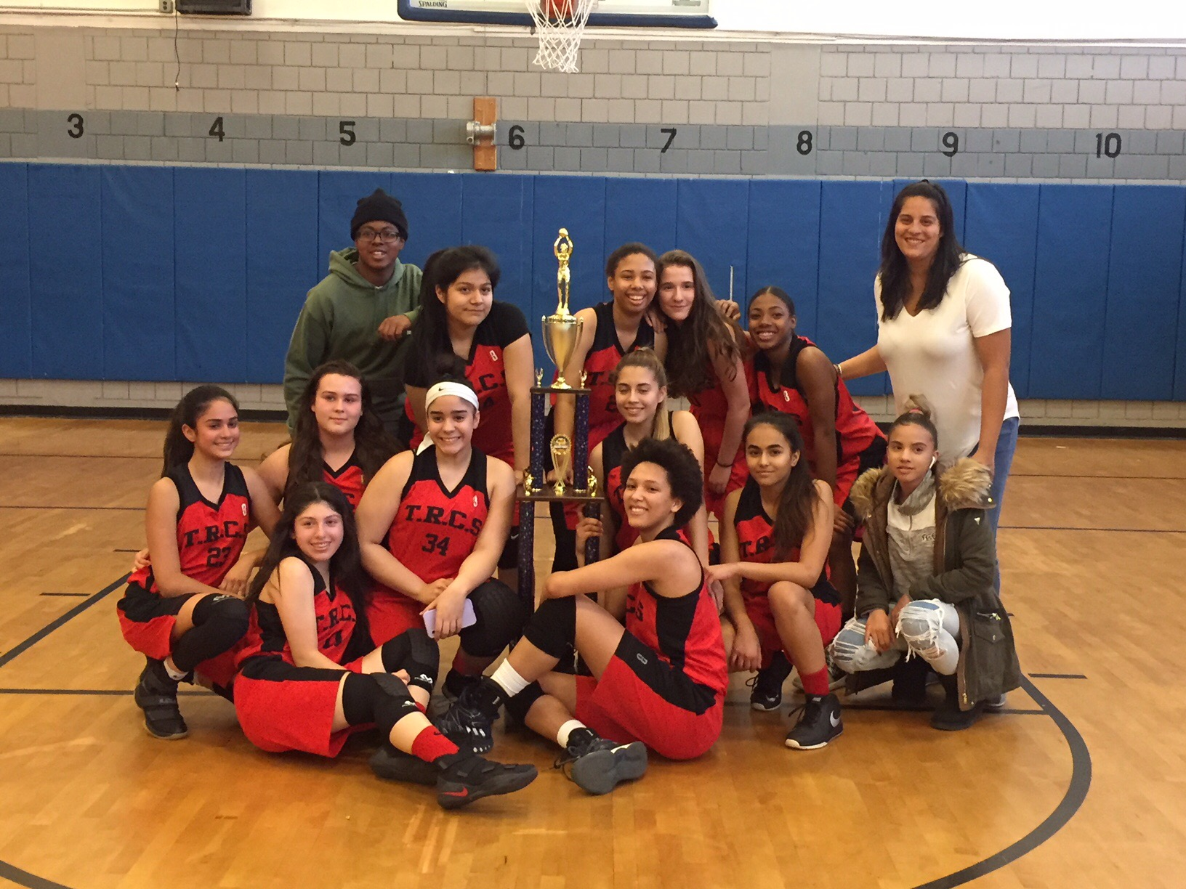
Notes:
NOTE: SLIDES 1-19 WILL SCROLL, 6PM PRESENTATION STARTS ON SLIDE 20!

Slide 38
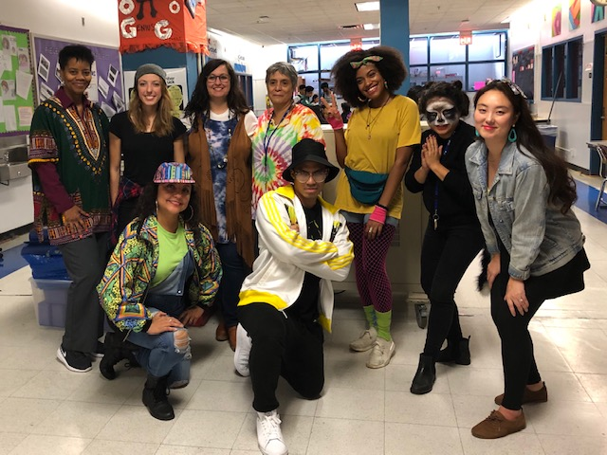
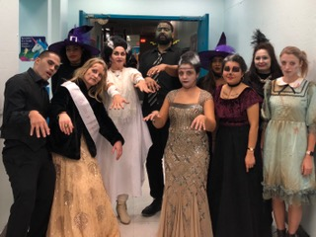
Spirit Week!!!
Student Government in Collaboration with SHS and NHS
*Always done the week of halloween!
-Activities that we always have:
Halloween: Dress up
Pajama day!!
Heritage Day!
*many more are added each year*
*Both teachers and students participate*
Notes:
NOTE: SLIDES 1-19 WILL SCROLL, 6PM PRESENTATION STARTS ON SLIDE 20!

Slide 39
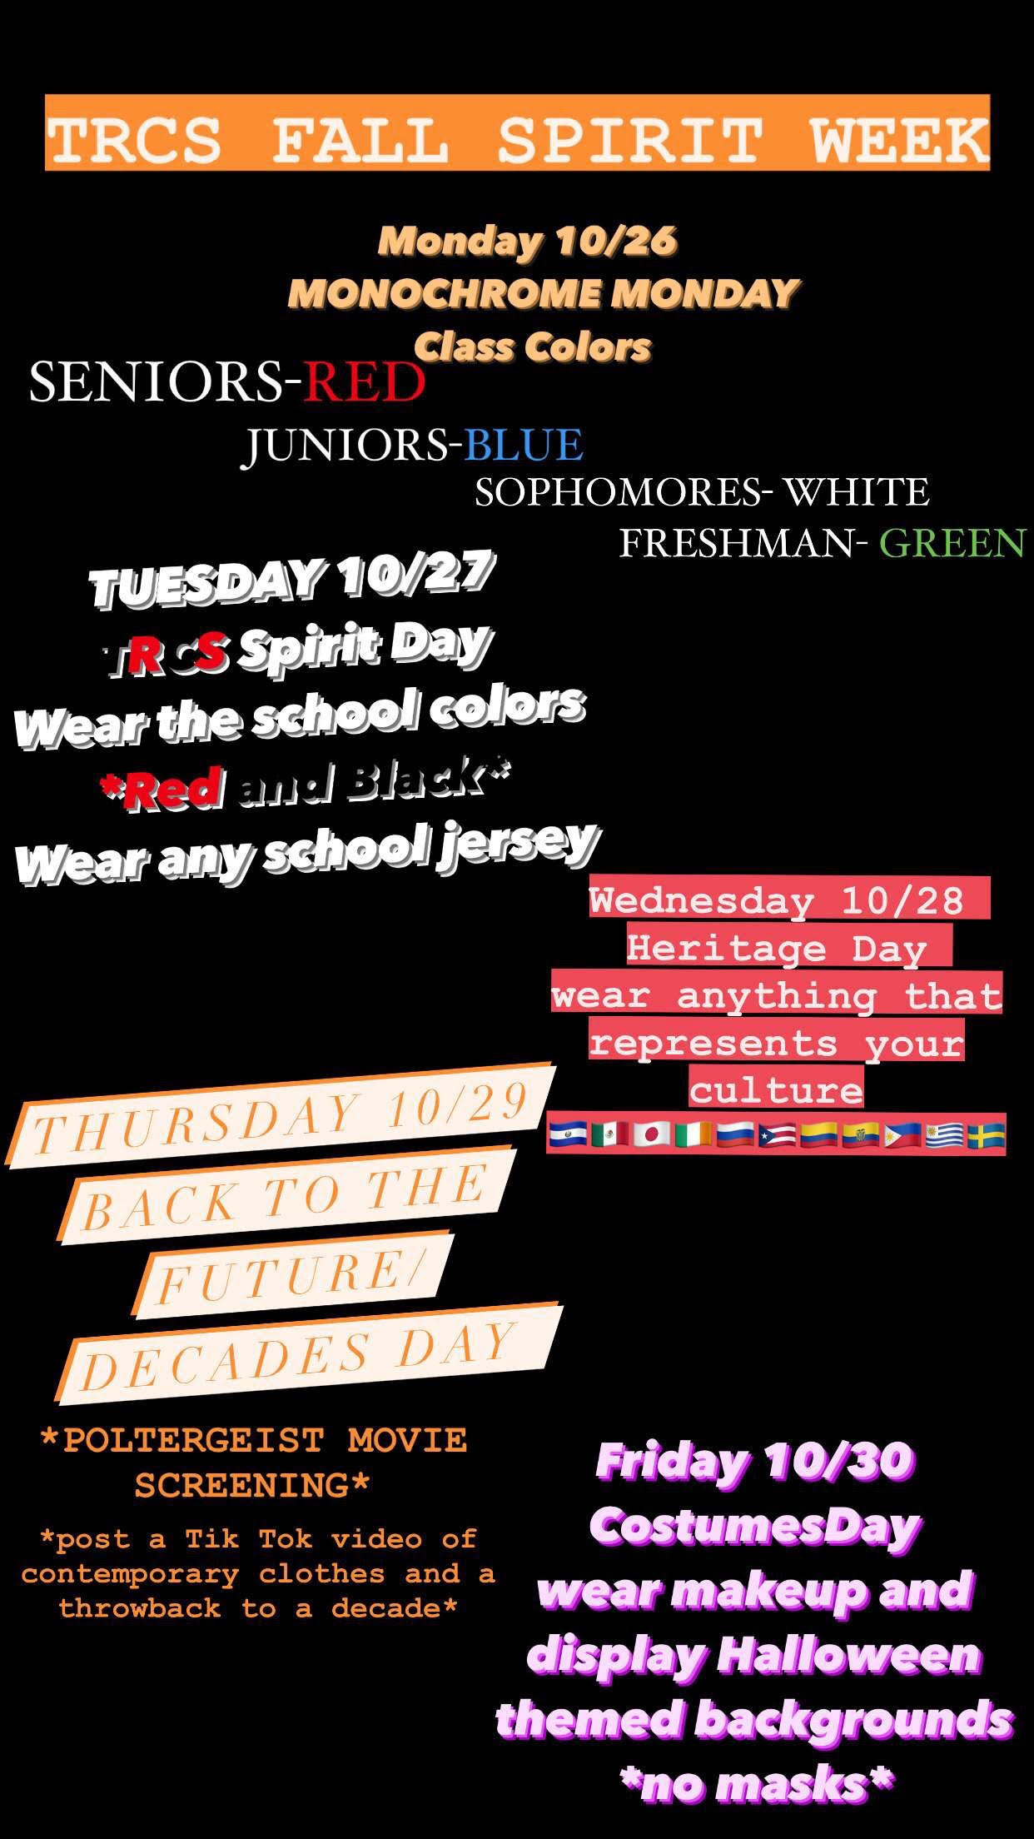
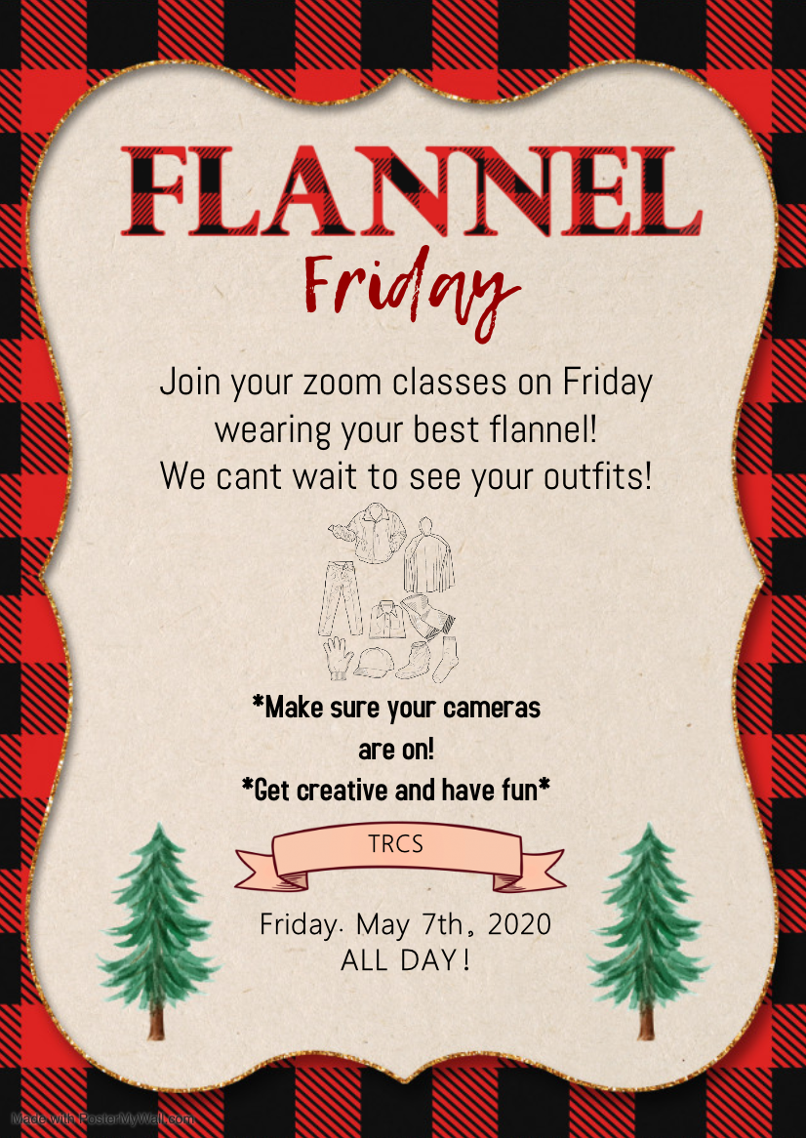
Spirit Week 2020 and different drives and events
that HS Student Government held during remote learning
Notes:
NOTE: SLIDES 1-19 WILL SCROLL, 6PM PRESENTATION STARTS ON SLIDE 20!

Slide 40
The Arts Classes
*There are three options:
-Theatre with Rebecca S.
-Art with Robert
-Music with Katie
In the beginning of the school year, you will have the chance of “dipping your toe” in 3 art classes. This will help you make your final decision where you chose one of the arts to focus on for the rest of high school. Along with your decision, you have to include a 1-page essay, where you explain your top three choices in order.
This decision cannot be changed!
Notes:
NOTE: SLIDES 1-19 WILL SCROLL, 6PM PRESENTATION STARTS ON SLIDE 20!

Slide 41
Rensizzle
Rensizzle has multiple options. Rensizzle can have you gain the experience to look at people's ideas and likes about a subject. Rensizzle can also help you be more fond when it comes to being part of your dream job.
Some Rensizzles are :
Graphic Novel - Farm to Table
Graffiti - The Happiness Project
Geology - NYC: Then and Now
Culinary Arts and Careers - Ksizzle
Notes:
NOTE: SLIDES 1-19 WILL SCROLL, 6PM PRESENTATION STARTS ON SLIDE 20!

Slide 42
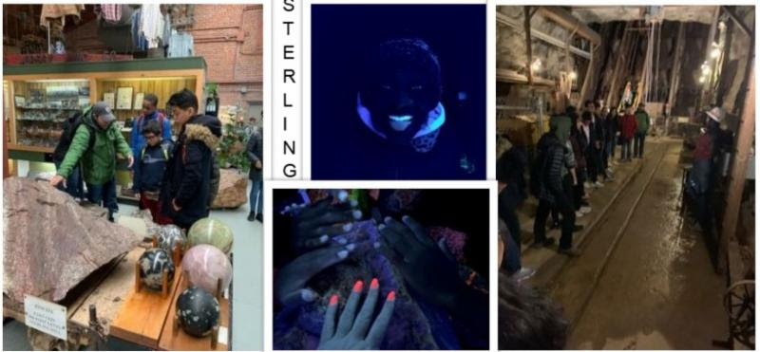
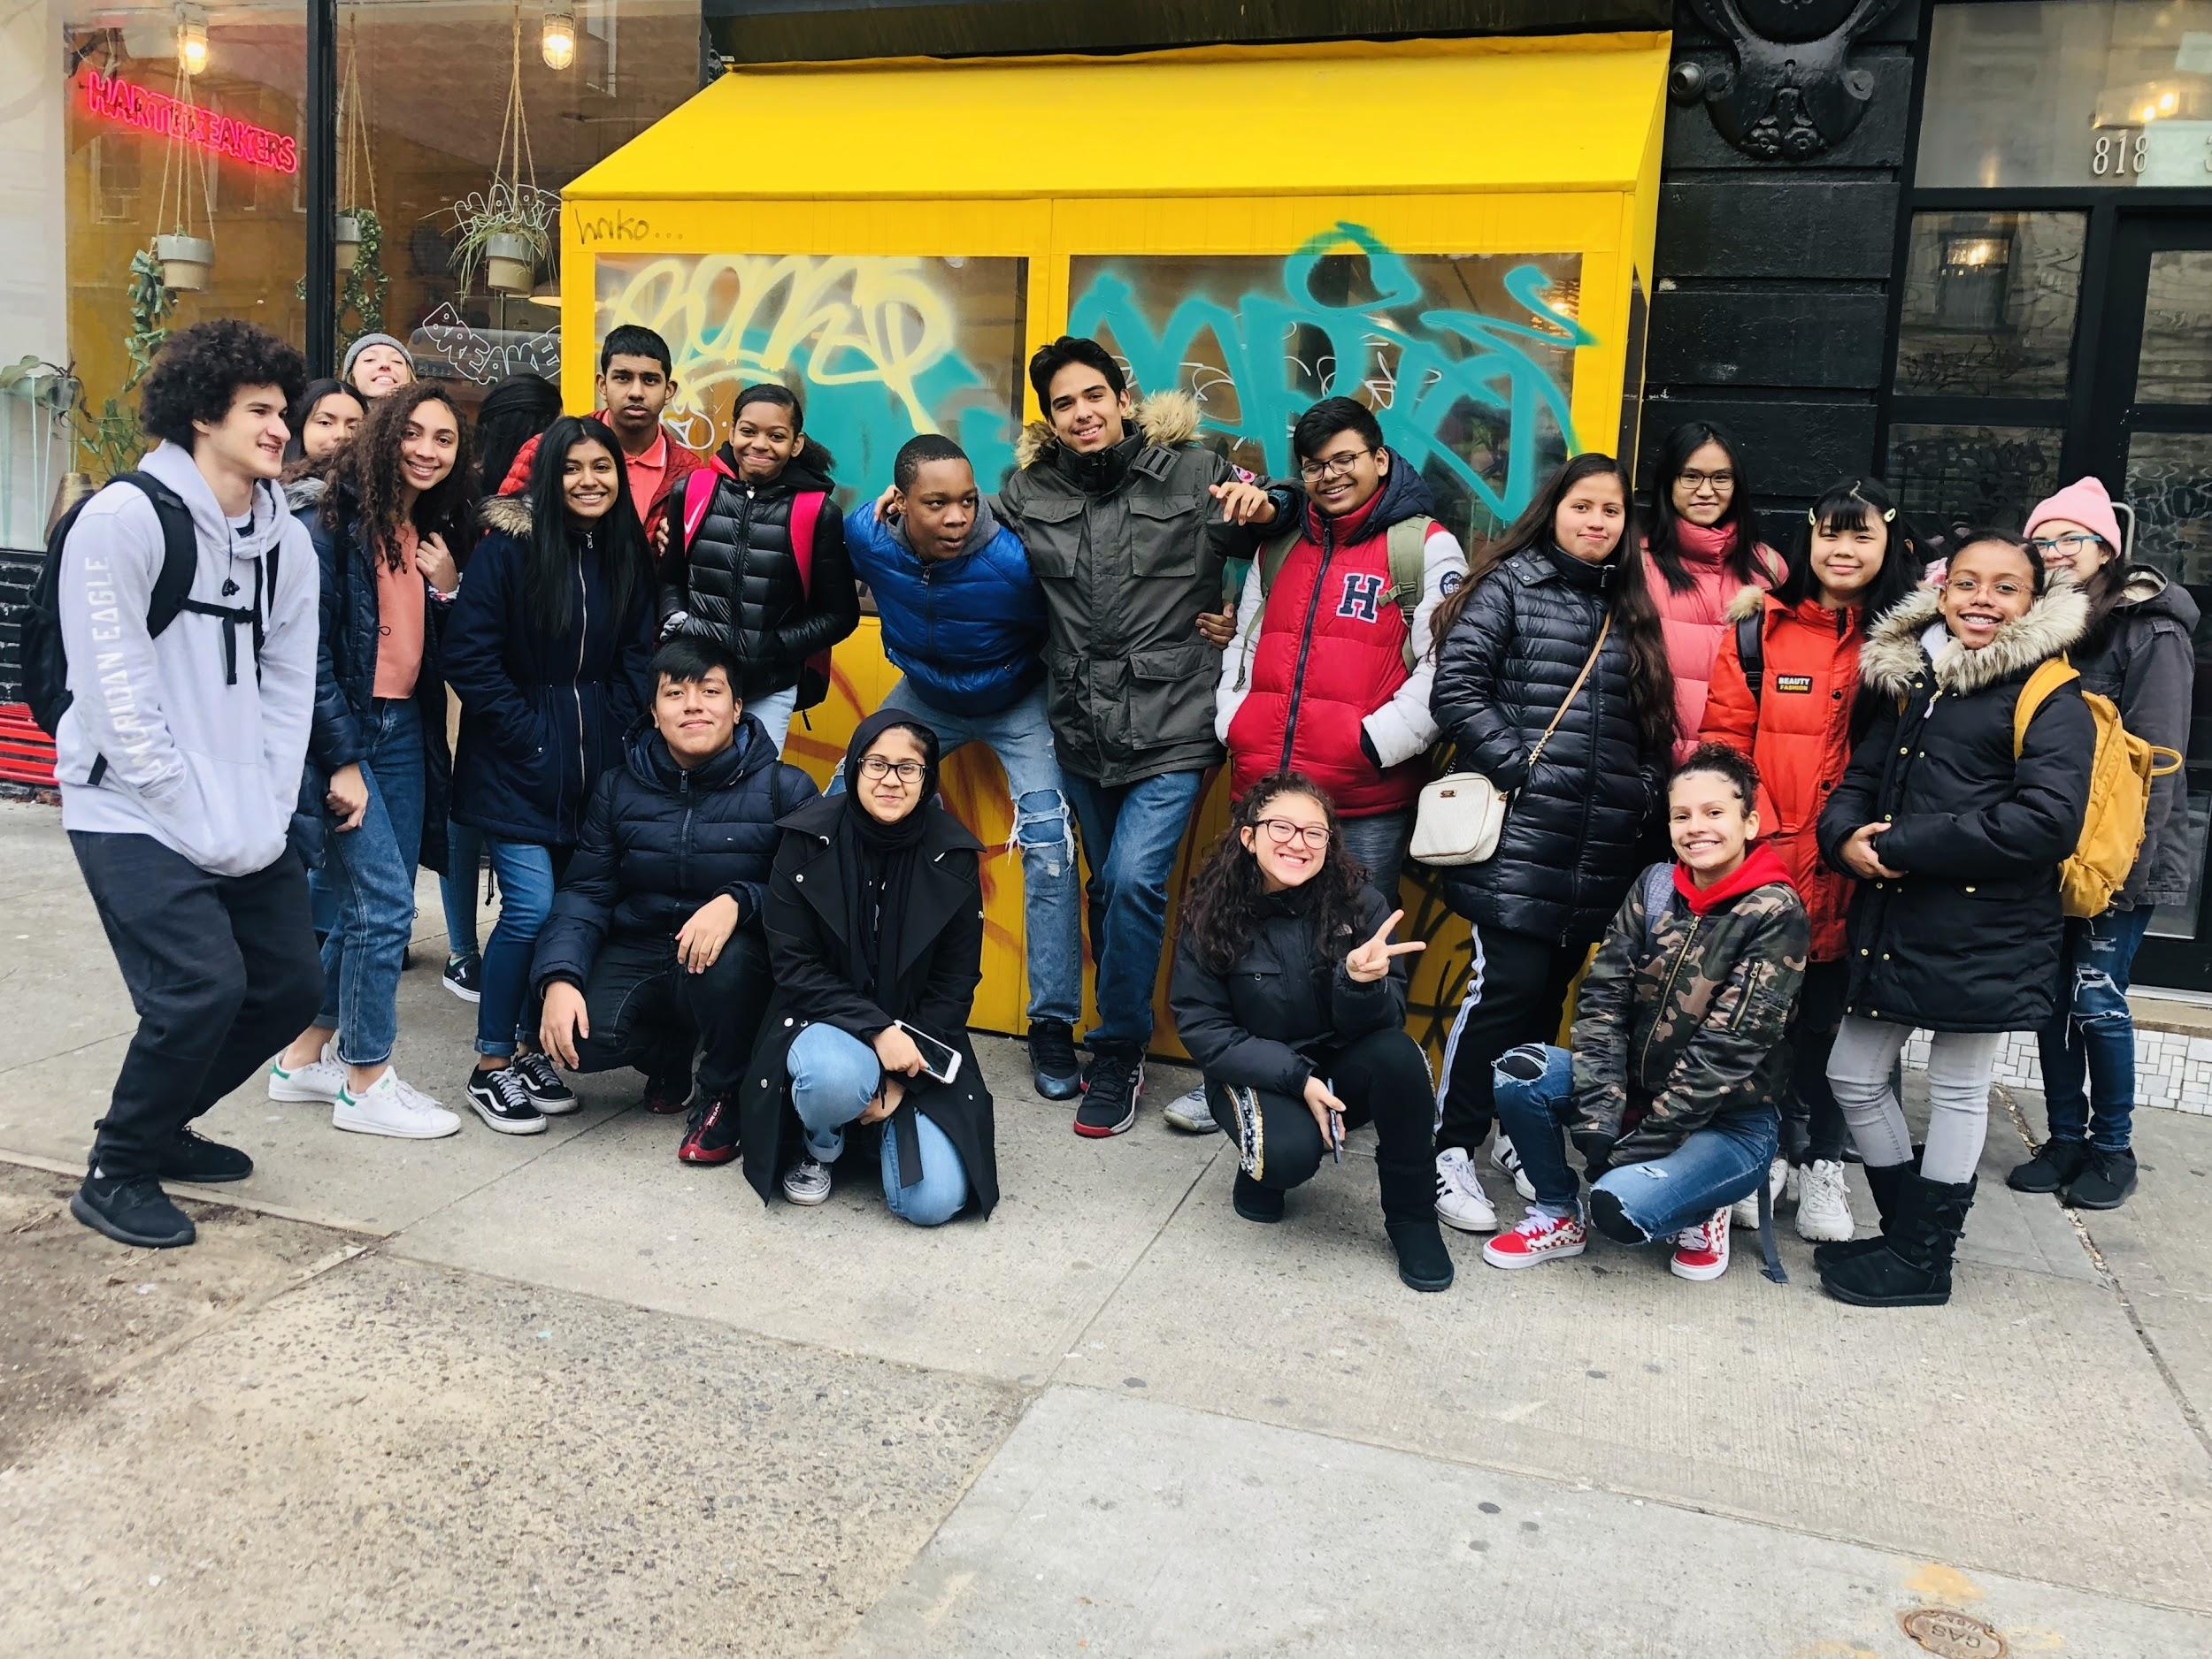
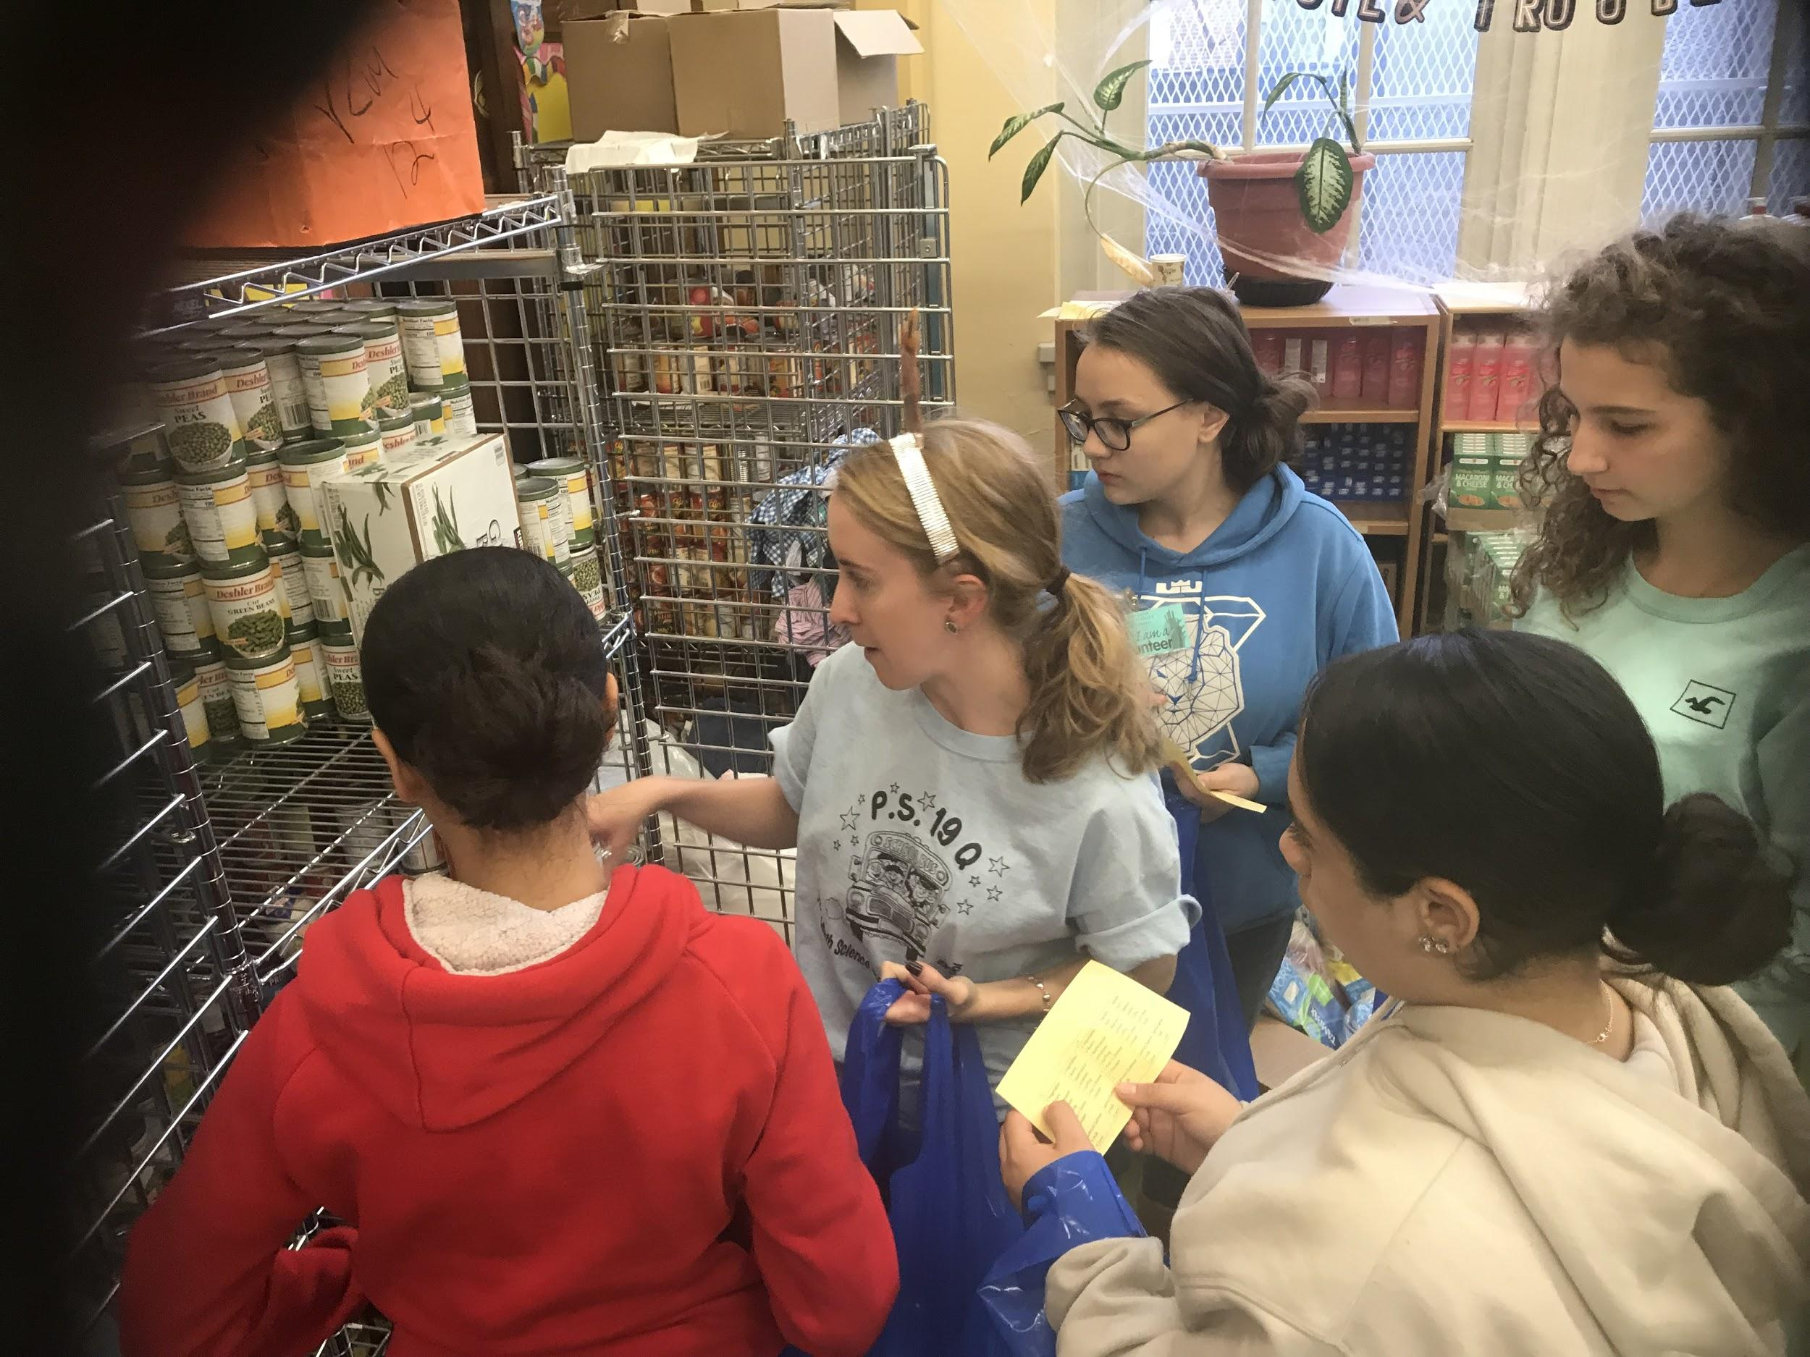
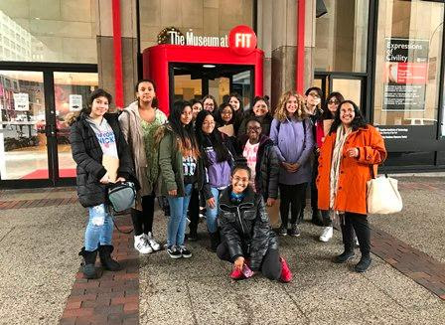
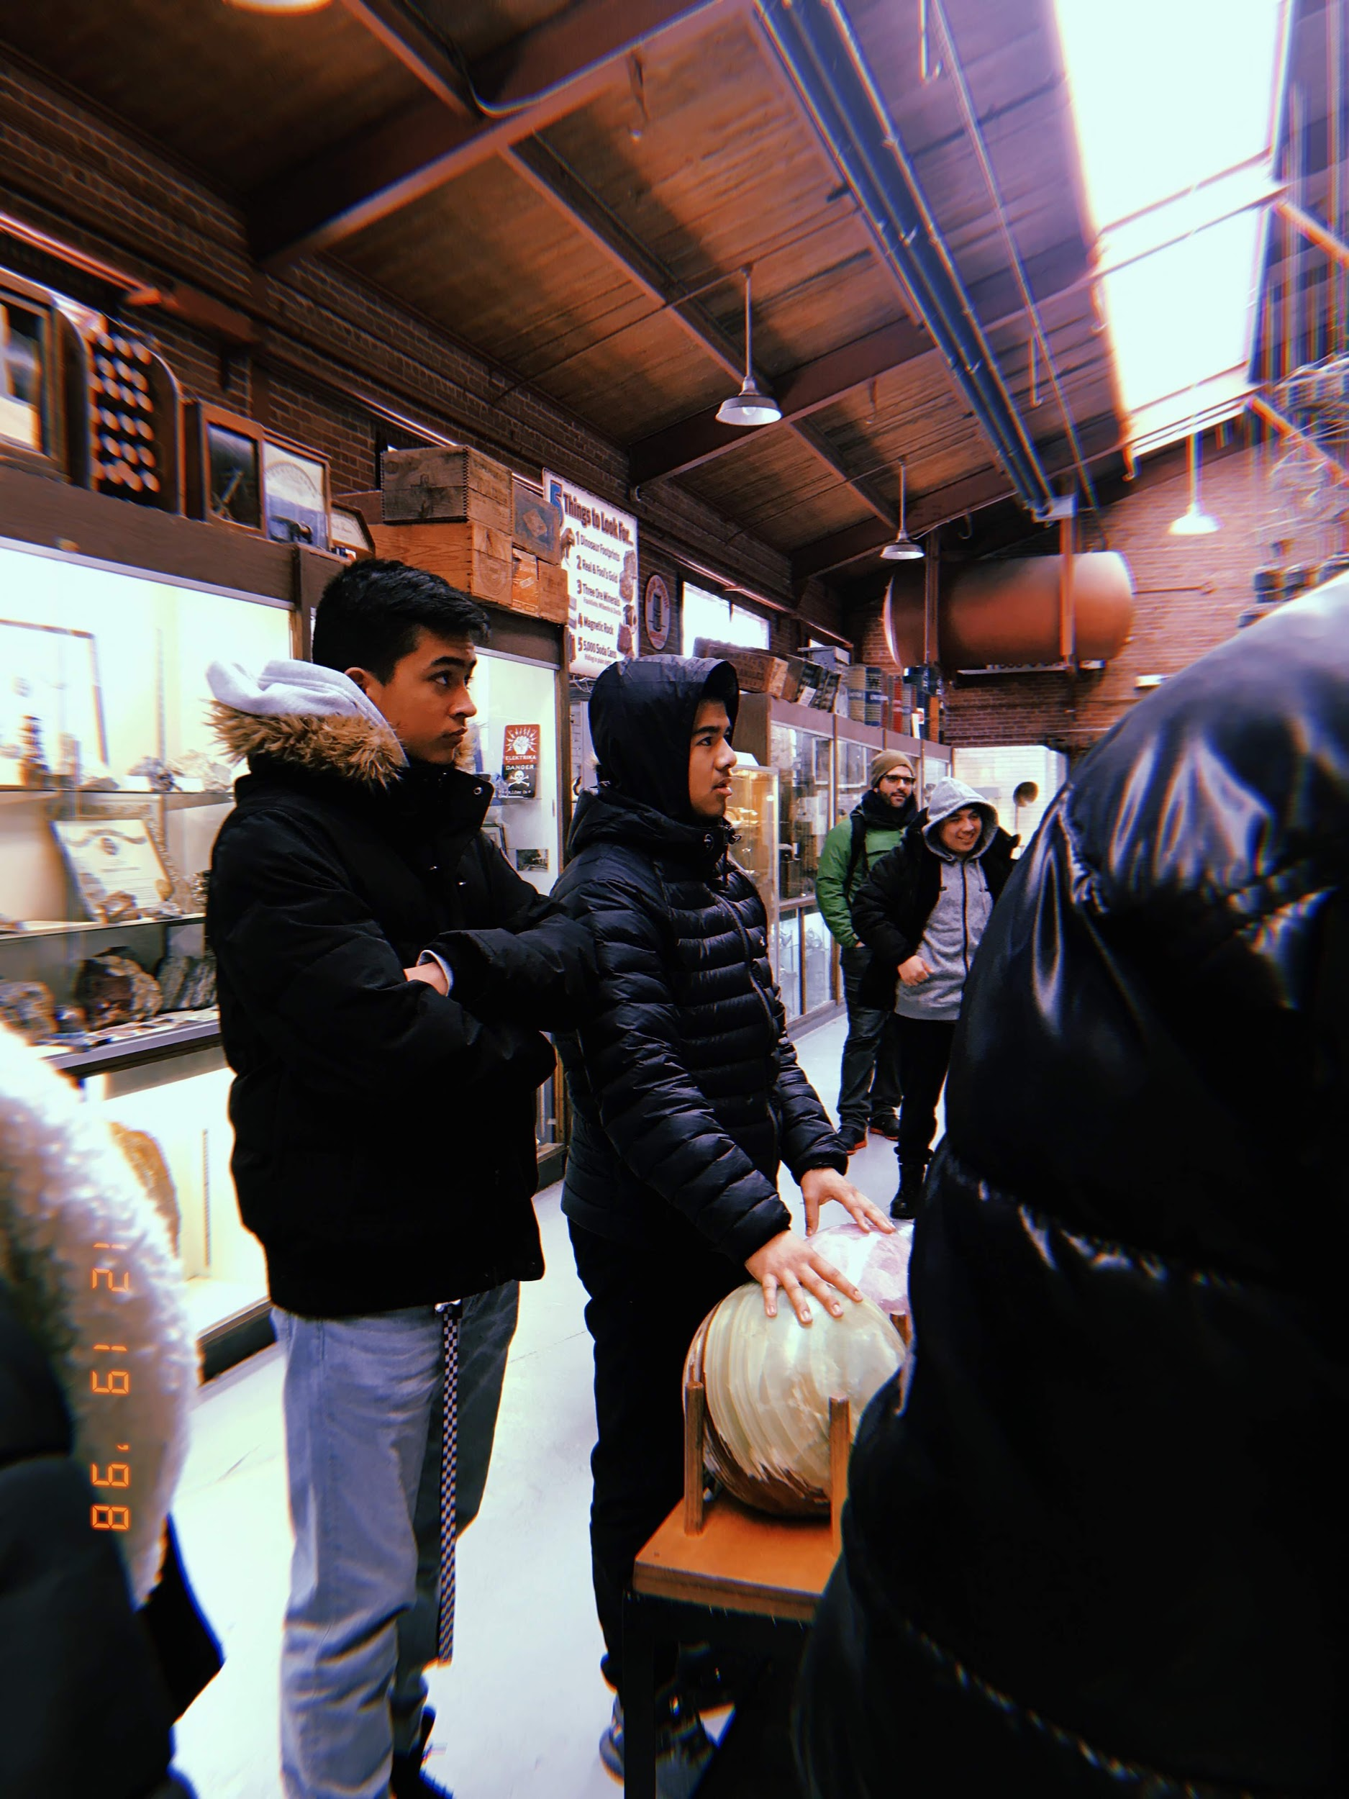
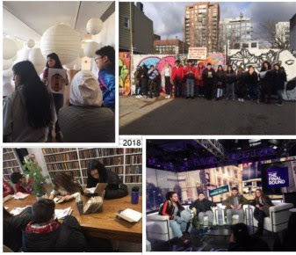
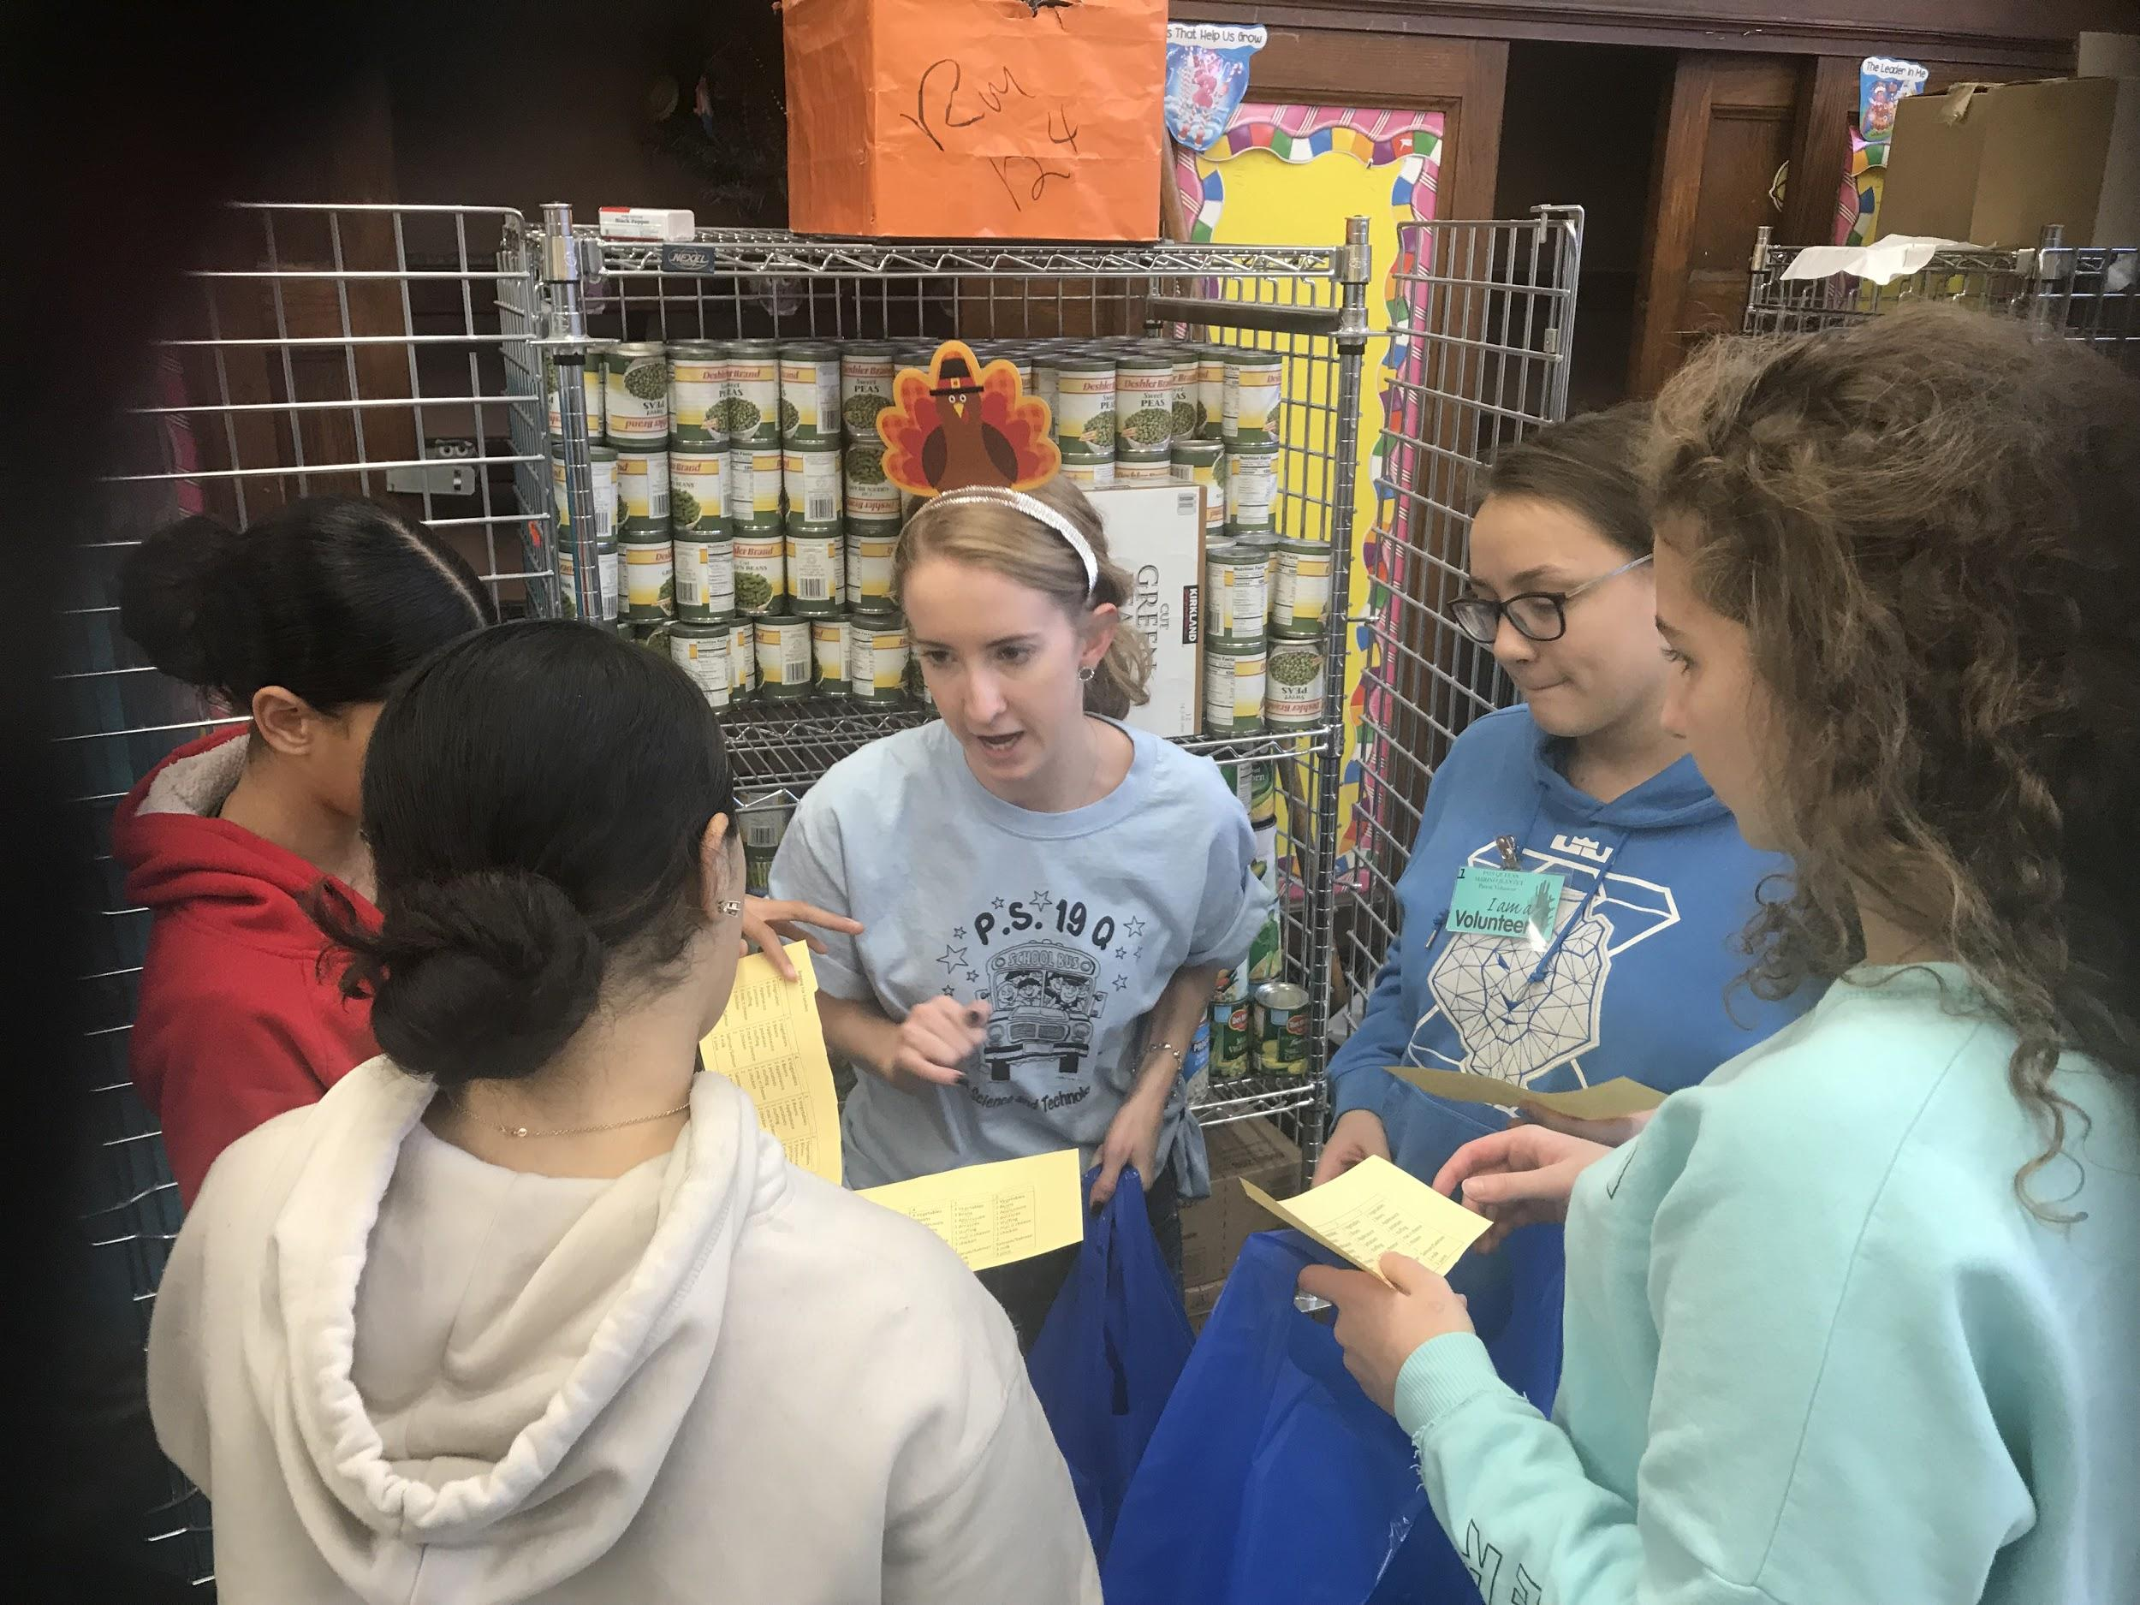
Rensizzle Pictures
Notes:
NOTE: SLIDES 1-19 WILL SCROLL, 6PM PRESENTATION STARTS ON SLIDE 20!

Slide 43
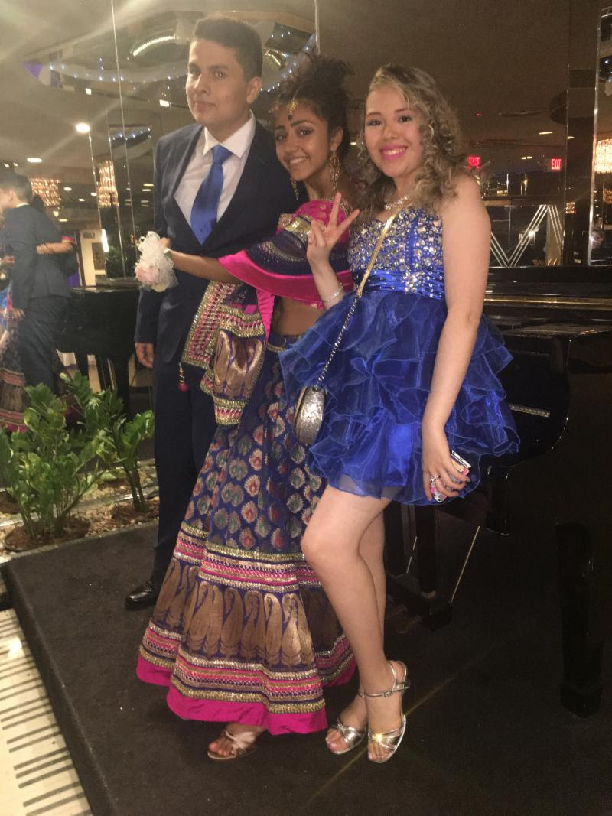
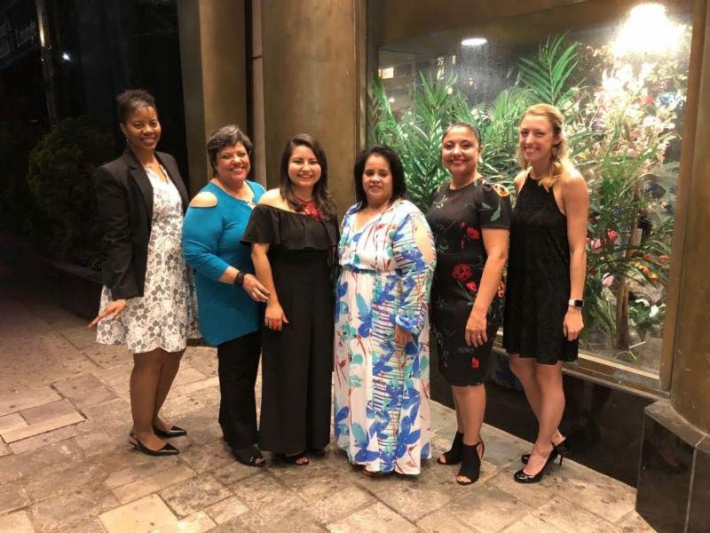
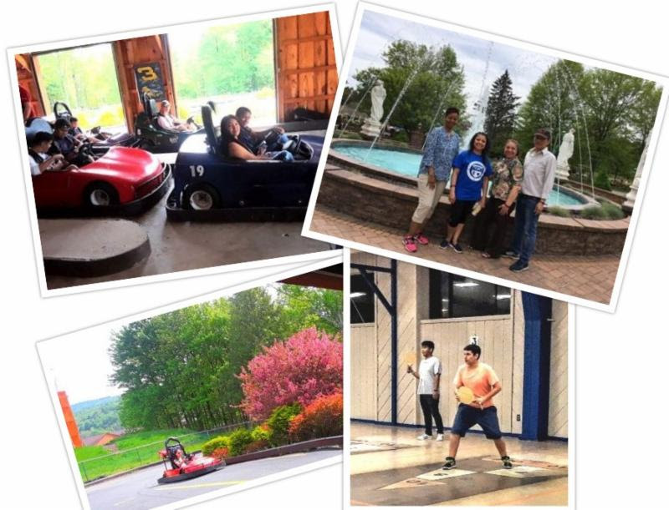
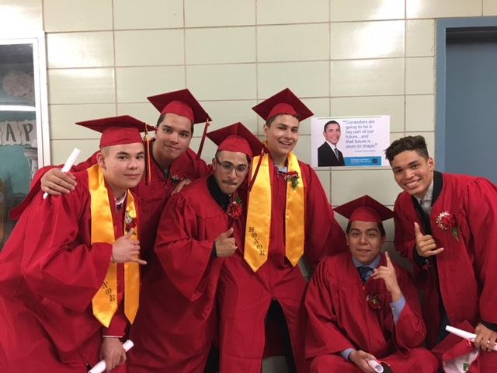
SENIOR: Prom, Trip & Graduation
Notes:
NOTE: SLIDES 1-19 WILL SCROLL, 6PM PRESENTATION STARTS ON SLIDE 20!

Slide 44
Remote school experiences:
Remote learning was an experience that us students could not have predicted. We could not have expected the challenges we would have had to face during these trying times. The communication between student and teachers allowed for a better experience this past year. They understood the struggles students faced and were flexible. All teachers allowed past work to be made up, retakes of test and quizzes to happen, and took away many of the stresses students had. These are the benefits of having such a small school like Renaissance.
Student voices were heard and HS Student Government does our best to take action !
Notes:
NOTE: SLIDES 1-19 WILL SCROLL, 6PM PRESENTATION STARTS ON SLIDE 20!

